Slide 1
Module 1 Ecological Concepts and Definitions
Presented by
Osmangazi Municipality

Slide 2
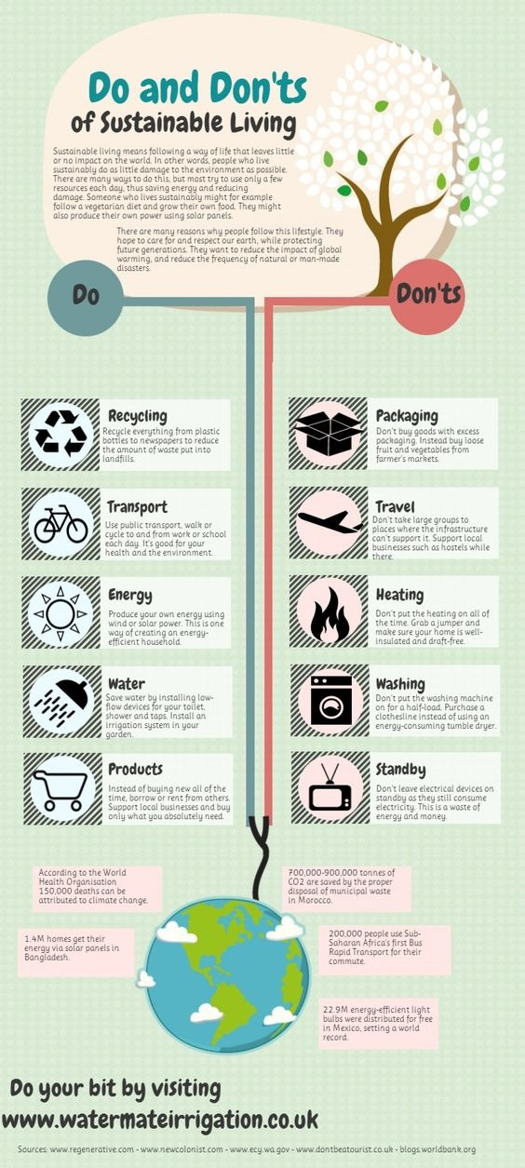
Lesson Plan 1: LIVING SOIL
Purpose / Learning objectives:
Concept of sustainability and sustainable agriculture
Knowledge about sustainable agricultural practices and their environmental and social benefits.
Notes:
https://ecolifewise.com/what-is-sustainability-unlocking-the-power-to-transform-our-world/

Slide 3
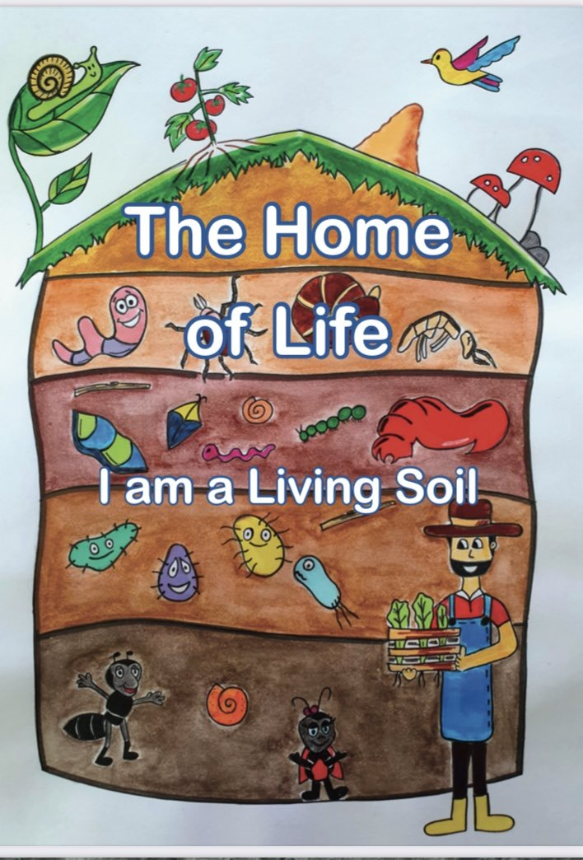
Lesson Plan 1: LIVING SOIL
Intersecting objectives:
Reducing environmental damage
Ensuring the protection of natural resources
Prevention of environmental pollution
Producing high quality products
Keeping the economy alive in the short and long term
Improve the quality of life of those engaged in agriculture and
Develop practices for this purpose

Slide 4
Lesson Plan 1: LIVING SOIL
Facilitation:
Getting knowledge about natural resources
Knowing environment
Managing features
Knowing socioeconomic impacts
Long-term income of the producer
Always use recyclable or recycled materials.
Let them get a little dirty with nature
Notes:
https://www.shutterstock.com/tr/image-photo/hand-planting-trees-technology-renewable-resources-2057392145

Slide 5
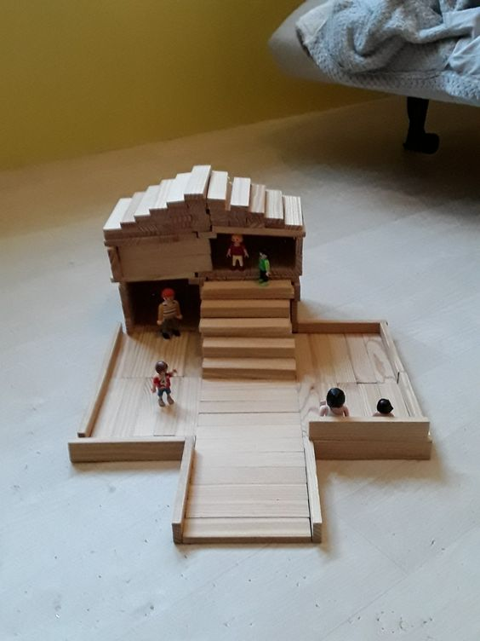
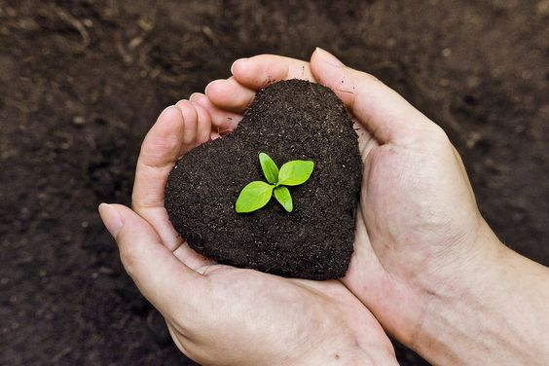
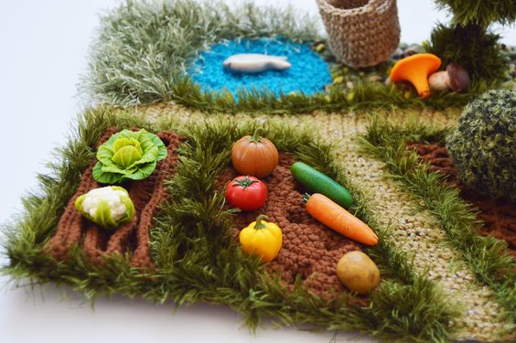
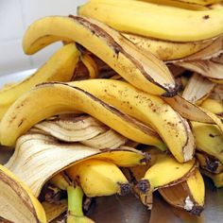
Lesson Plan 1: LIVING SOIL
Resources required:

Slide 6
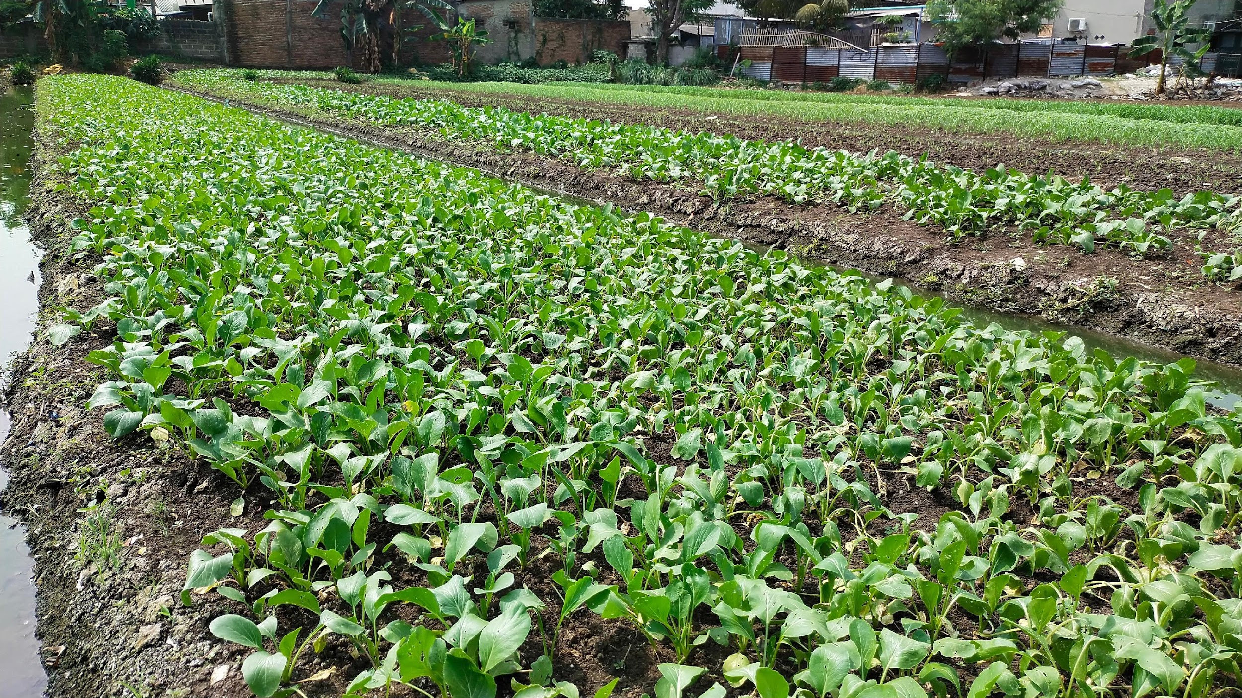
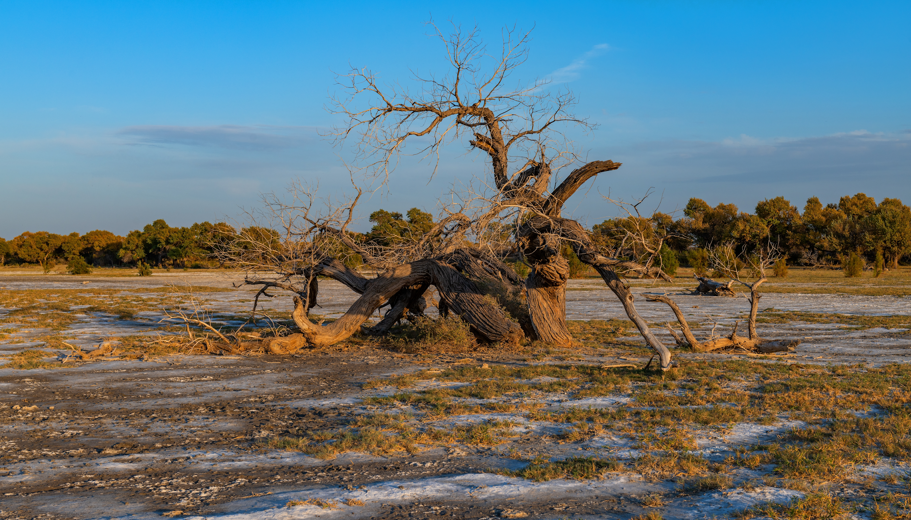
Lesson Plan 1: LIVING SOIL
Implementation
Instructions step by step:
What is agriculture?
What is sustainability?
What is sustainable agriculture?
What do you think are the objectives of this lesson?
Notes:
https://www.shutterstock.com/image-photo/agricultural-land-that-intended-suitable-be-2317670307
https://www.shutterstock.com/image-photo/turanga-variety-poplar-on-soil-unsuitable-2210429981

Slide 7
Lesson Plan 1: LIVING SOIL
Implementation
Hands on activity / farm - based learning -1:
Prepared eligible and ineligible agricultural land model
Complete the lecture by facilitating discussion with students through these two models.

Slide 8
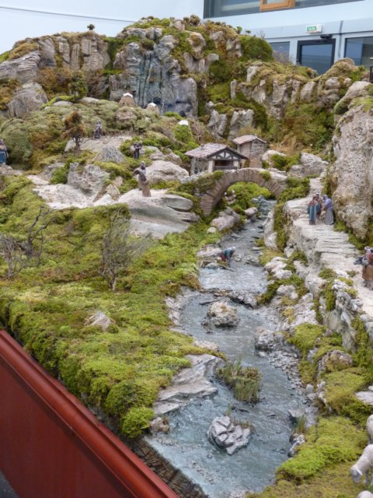
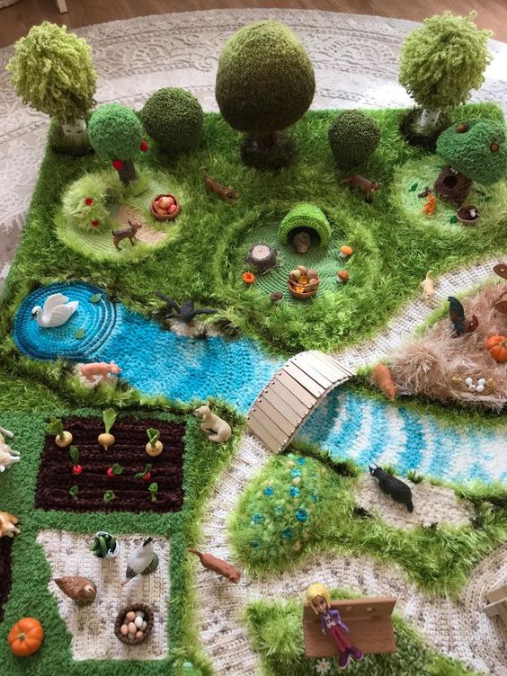
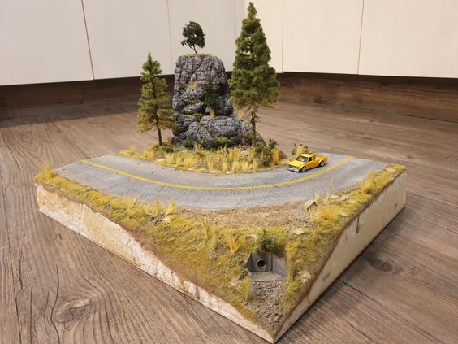

Slide 9
Lesson Plan 1: LIVING SOIL
Implementation
Hands on activity / farm - based learning -2:
Divide the class into individual groups
Give some of them fertile soil and infertile soil for the others
Give wheat seeds (grass), a container and water and plant
Cut the banana peels they consume during class into small pieces and bury them in their soil
Sufficient water fertile soil and less water to infertile soil
Monitor grass growth in both soil and discuss for a week

Slide 10
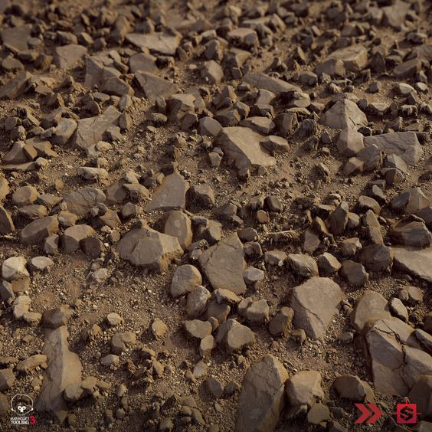
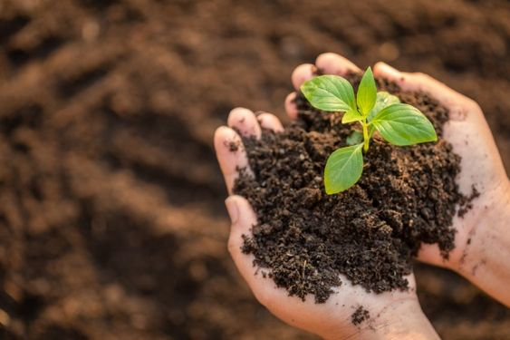
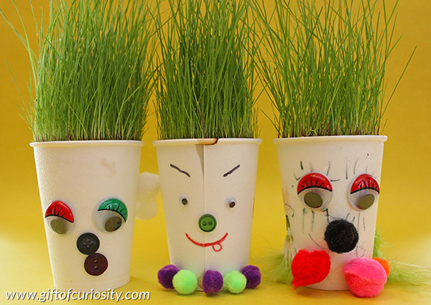

Slide 11
Lesson Plan 1: LIVING SOIL
Implementation:
Hands on activity / farm - based learning-3:
Play computer games related to sustainable agriculture.

Slide 12
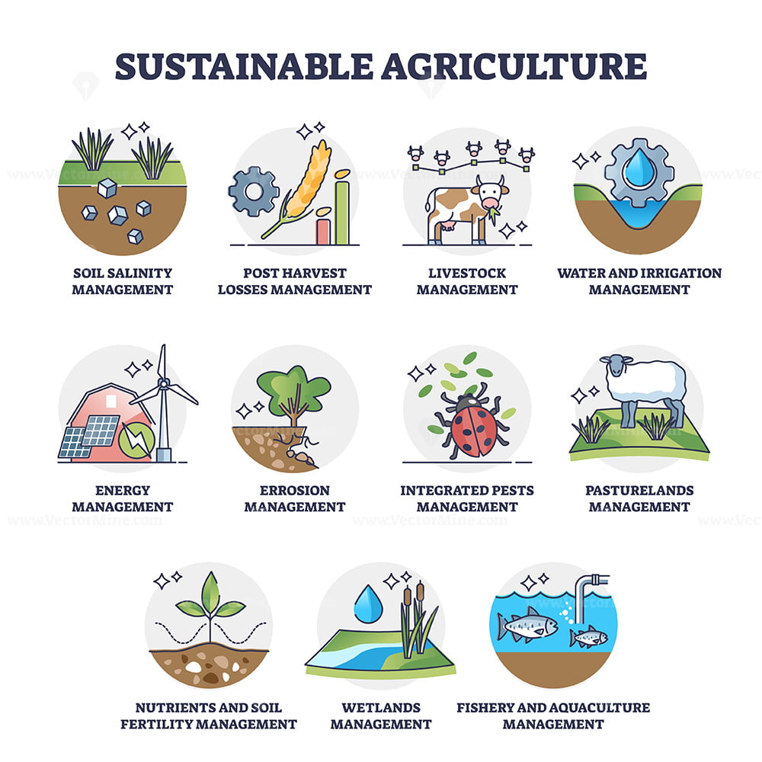
Lesson Plan 2: FELLOWS OF THE SOIL
Purpose / Learning objectives:
Concept of sustainability and sustainable agriculture
How to use natural resources more efficiently within the scope of sustainable agricultural practices
How water and light impact soil health by observing soil organisms and plant health in different conditions.

Slide 13
Lesson Plan 2: FELLOWS OF THE SOIL
Intersecting objectives:
Increasing productivity in agriculture
Ensuring the protection of natural resources
Prevention of environmental pollution
Producing high quality products

Slide 14
Lesson Plan 2: FELLOWS OF THE SOIL
Facilitation:
Always use recyclable or recycled materials.
Let them get a little dirty with nature.
Ensure that all materials are ready
(internet, soil, etc.) before the lesson.
Notes:
https://www.shutterstock.com/tr/image-photo/spring-blossom-background-beautiful-nature-scene-1033292395

Slide 15
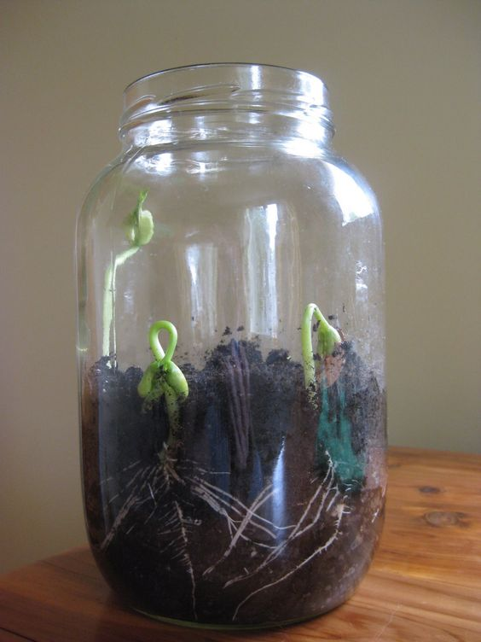
Lesson Plan 2: FELLOWS OF THE SOIL
Resources required:

Slide 16
Lesson Plan 2: FELLOWS OF THE SOIL
Implementation
Instructions step by step:
What is a natural resource?
What is the source of the light?
What is the importance of water in our life?
What do you think is the purpose of this lesson?
Notes:
https://www.shutterstock.com/image-photo/agricultural-land-that-intended-suitable-be-2317670307
https://www.shutterstock.com/image-photo/turanga-variety-poplar-on-soil-unsuitable-2210429981

Slide 17
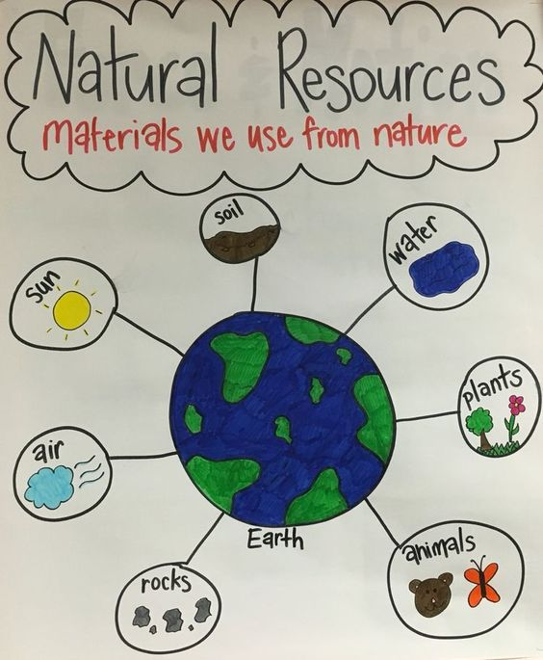

Slide 18
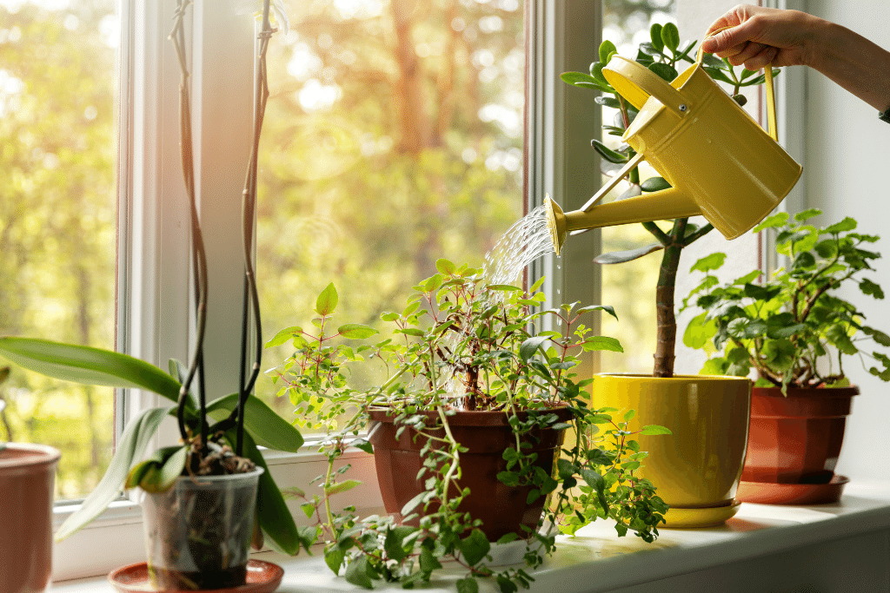
Lesson Plan 2: FELLOWS OF THE SOIL
Implementation
Hands on activity / farm - based learning -1:
Divide the class into individual groups
Each group fills each container with an equal amount of soil and plant a few grass seeds or place a small seedling in each container.
Each group is asked to label the containers as in the plan and follow the directions.
Observe the soil in each container to look for signs of soil organisms like earthworms, insects, and microbial activity and measure the growth of the plants in each container.

Slide 19
Lesson Plan 2: FELLOWS OF THE SOIL
Implementation
Hands on activity / farm - based learning -2:
Divide the class into individual groups
Distribute recycling materials to their group
Make Large flower with symbols of soil, water, air
and sun

Slide 20
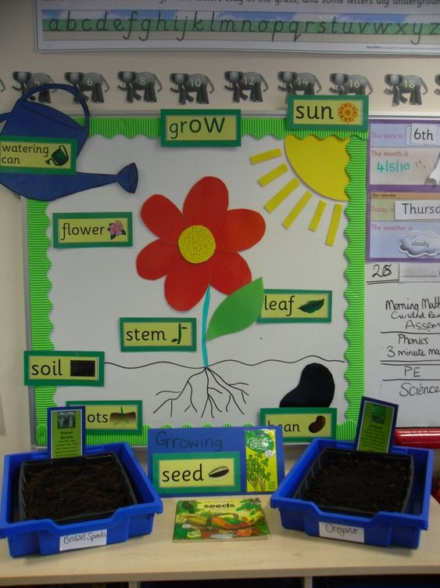

Slide 21
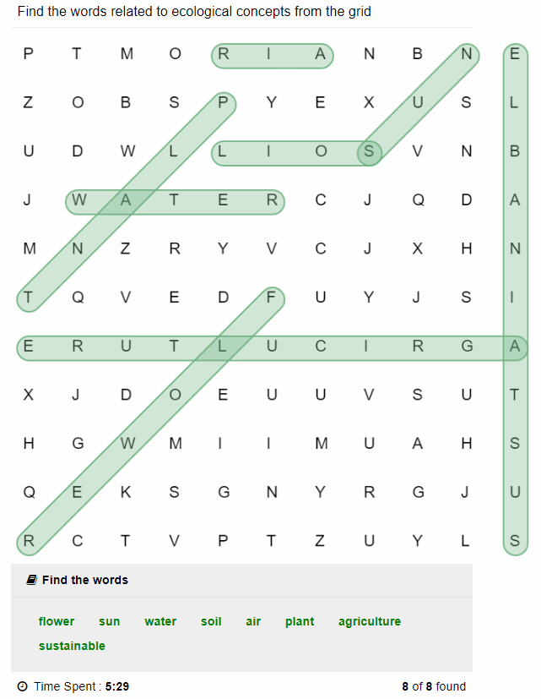
Lesson Plan 2: FELLOWS OF THE SOIL
Play a word game consisting of words with special features digitally.

Slide 22
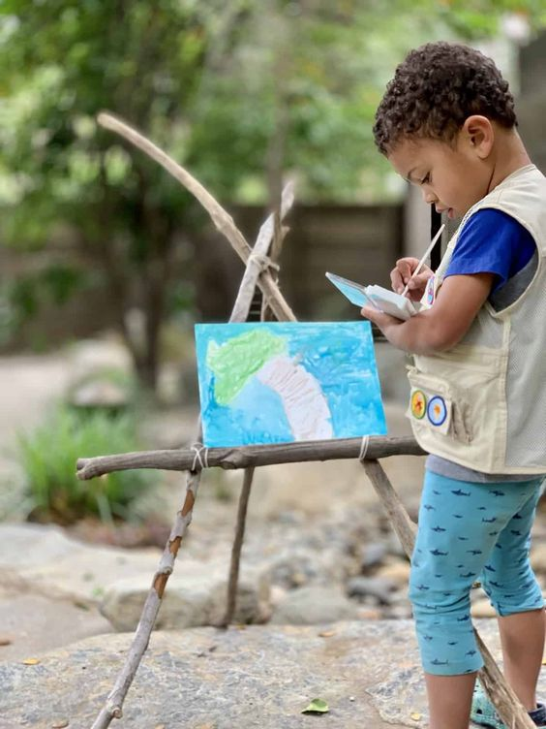
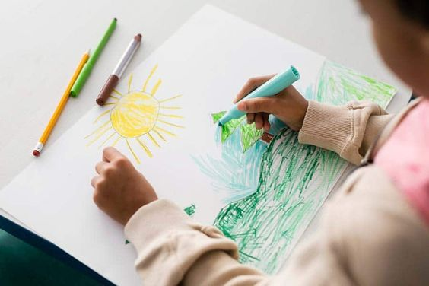
Lesson Plan 2: FELLOWS OF THE SOIL
Implementation:
Hands on activity / farm - based learning -3:
Ask to create a world with what they remember about sustainable agriculture by painting

Slide 23
Thank you for your attention!
Module 1
Ecological Concepts and Definitions
Osmangazi Municipality
Co-funded by the European Union. Views and opinions expressed are however those of the author(s) only and do not necessarily reflect those of the European Union or the European Education and Culture Executive Agency (EACEA). Neither the European Union nor EACEA can be held responsible for them.

