Slide 1
Module 2 Learning through Physical Games on the farm
Presented by
Grundzāles pamatskola

Slide 2
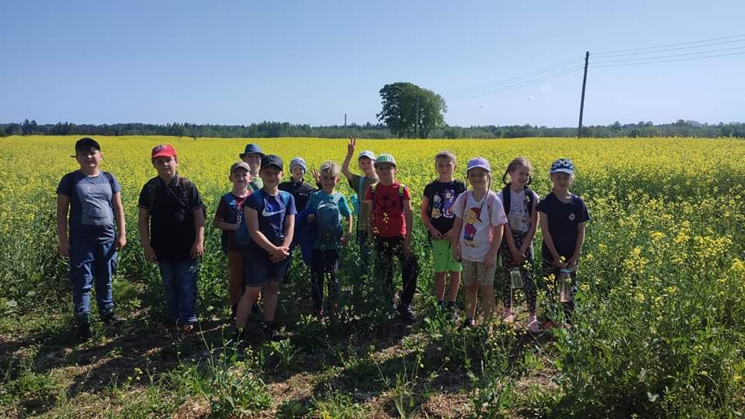
Lesson 1 PLANT BIOLOGY AND GENETICS. What is GMO?
Learning objectives
students can define terms GMO and non GMO
students can distinguish GMO from non-GMO products
students can understand current labeling on GMO food products
students can separate GMO misconceptions from facts
Students age - 12 years old

Slide 3
Lesson 1 PLANT BIOLOGY AND GENETICS. What is GMO?
Pre-activity: teachers asks students to think if they have heard smth about GMO OR students can go to the shop or farm to check the labels of products.
Teacher screens the photos of GMO products or not GMO (19 pictures) or gives them to students and let them sort.
Ask your students the difference of the GMO or not GMO
watch the video (1,40 min) and write down or remember the main products

Slide 4
Lesson 1 PLANT BIOLOGY AND GENETICS. What is GMO?
watch the video and write down/ remember the main concerns/questions GMO and Food Safety
ask students to find in the internet resources how GMO products are marked. ( Worksheet -Labels)
divide students into 2 or 4 groups (against GMO and pro GMO: watch the video and write down PRO/CONS arguments. Discuss the main arguments.
GMO. Myth vs. facts - identify the following 8 statements as myth or facts
quiz “Genetic Engineering” - 10 questions

Slide 5
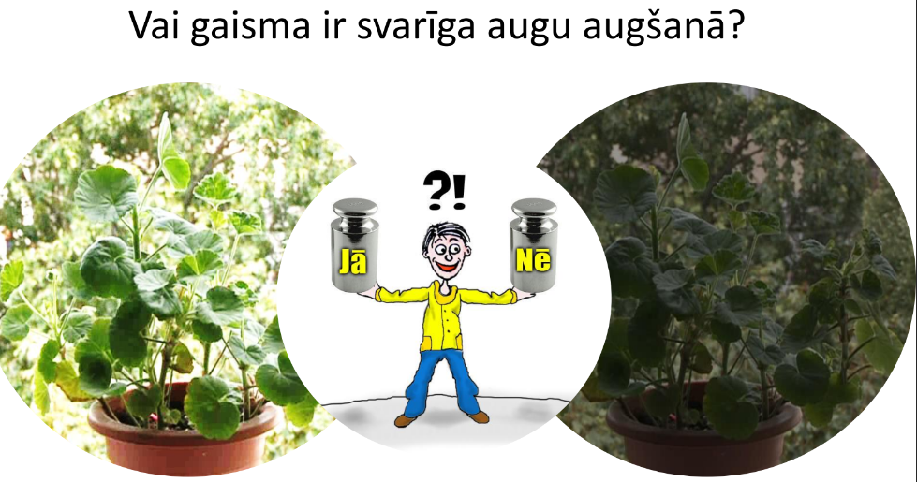
Lesson 2 What a seed need to grow? Plant Biology and Genetic. Plant physiology.
Learning objectives:
Students (9 years old) will understand how the different condition influence the development of organism
Conduct experiment on the effects of different growing conditions on plant growth.
Resources required:
containers, buckets
soil examples
stones, sand
heater

Slide 6
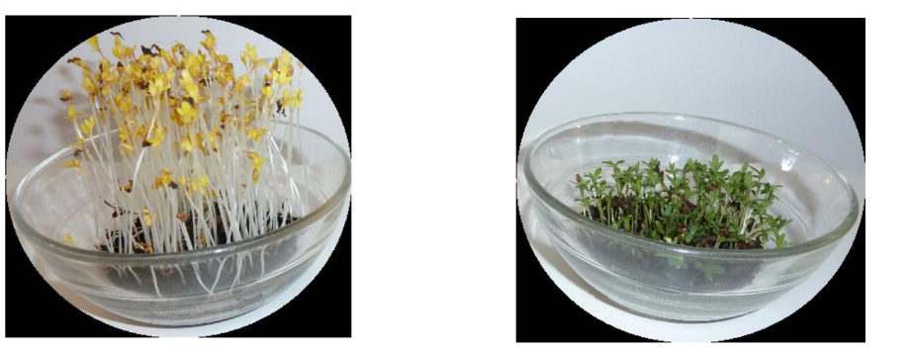
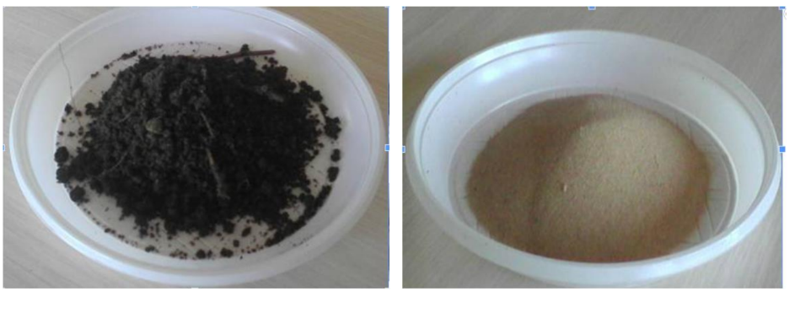
Lesson 2
Students are divided into 4 groups. They work in groups for next 10 minutes. Each group has its driving question.
Driving question: whether light is important for plant growth?
whether soil influences plant grow? whether water influences plant grow? whether temperature influences plant grow.

Slide 7
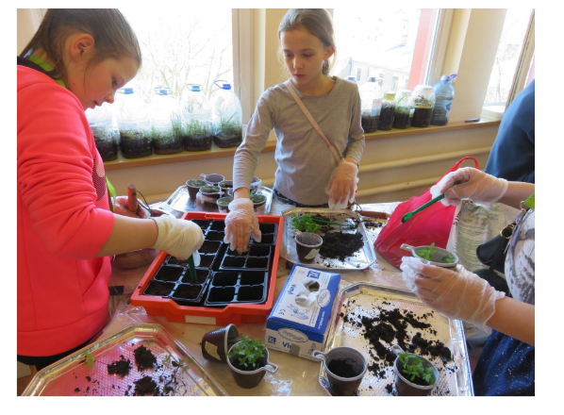
Lesson 2
Students prepare for the experiment by selecting the appropriate quantities (soil, light, heat, water) for their group. According to your group's conditions and question, sow the seeds and place them in the appropriate place.
After a week each group observe the results and come to conclusions.

Slide 8
Thank you for your attention!
Module 2
Learning through Physical Games on the Farm
Grundzāles pamatskola
Co-funded by the European Union. Views and opinions expressed are however those of the author(s) only and do not necessarily reflect those of the European Union or the European Education and Culture Executive Agency (EACEA). Neither the European Union nor EACEA can be held responsible for them.

