Slide 1
Module 3 Gamification in Farm with WEB 2.0 Tools
Presented by
OMEM

Slide 2
Module 3
Module 3: Gamification in Farm with WEB2.0 Tools.
Treasure hunt with Actionbound, Baamboozle farm quests, random group
Students will learn about the engineering principles behind agricultural equipment and structures.

Slide 3
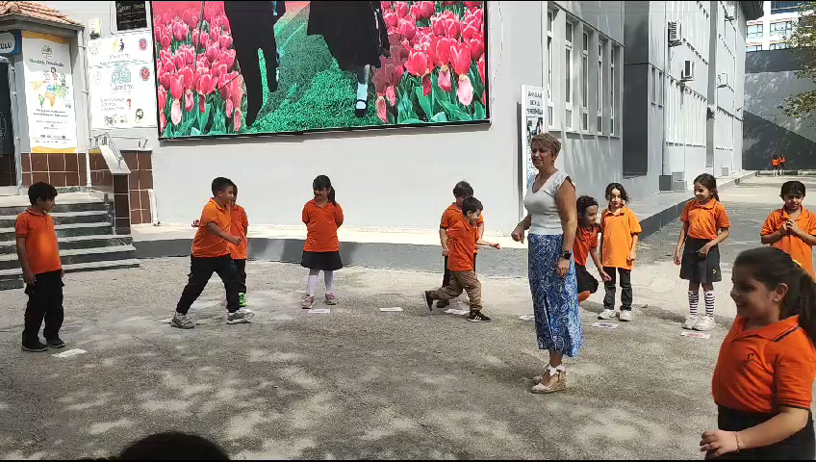
Lesson Plan 1: Fruitboozle
At the beginning of the lesson students play ‘ fruit basket game ‘
At the end of the game;
Teacher asks questions about fruit ( Do you know grapes ? / Which fruit grows when? Etc..)

Slide 4
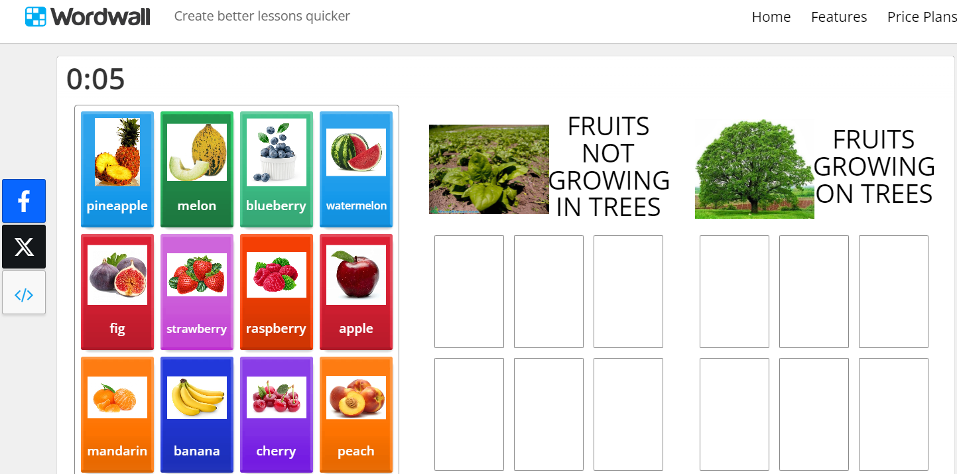
Lesson Plan 1: Fruitboozle
Teacher asks the students to introduce the fruits they brought from home.
Students discuss about the places where the fruit grow
https://wordwall.net/resource/17266562/where-do-fruits-grow

Slide 5
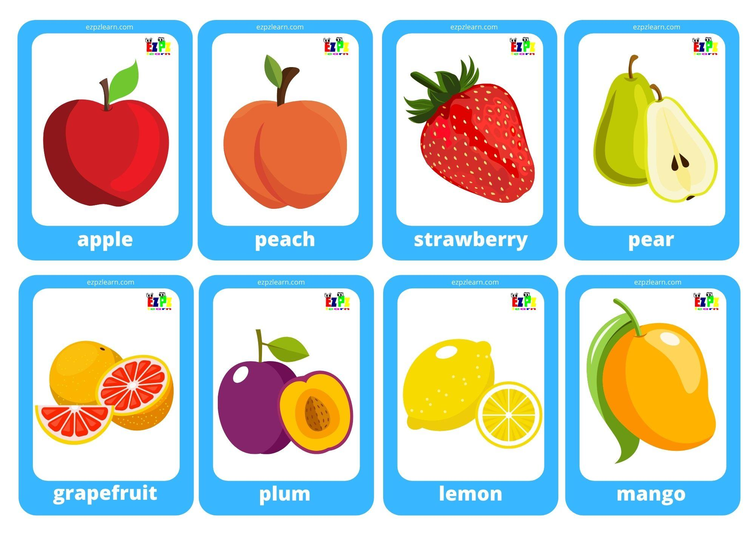
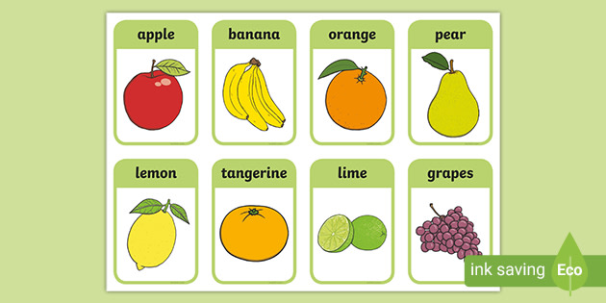
Lesson Plan 1: Fruitboozle
Materials:
Fruit basket game cards
Fruits from home

Slide 6
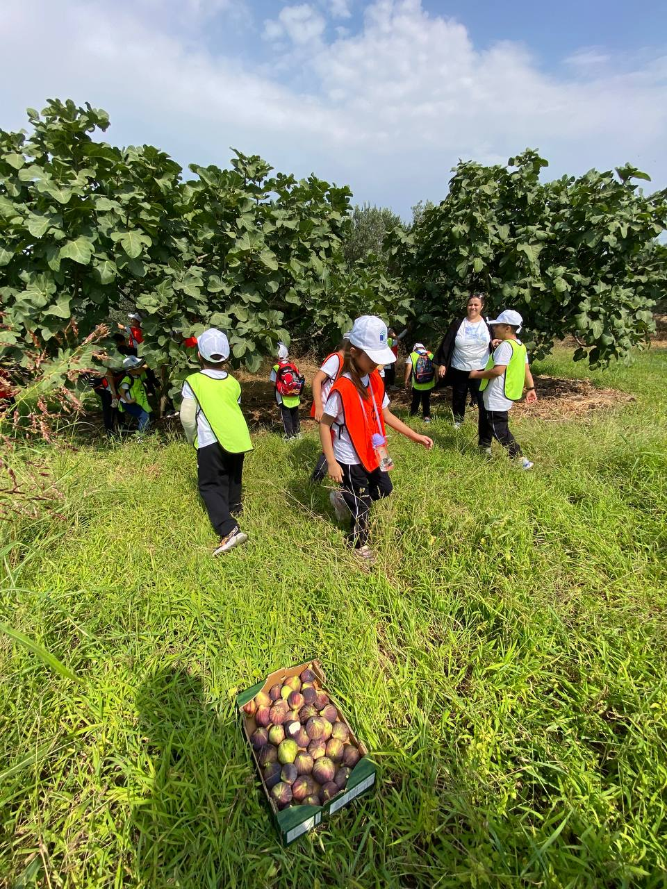
Lesson Plan 1: Fruitboozle
Teacher divides the students into four groups and asks them to make a list of seasonal fruits.
A trip to a farm

Slide 7
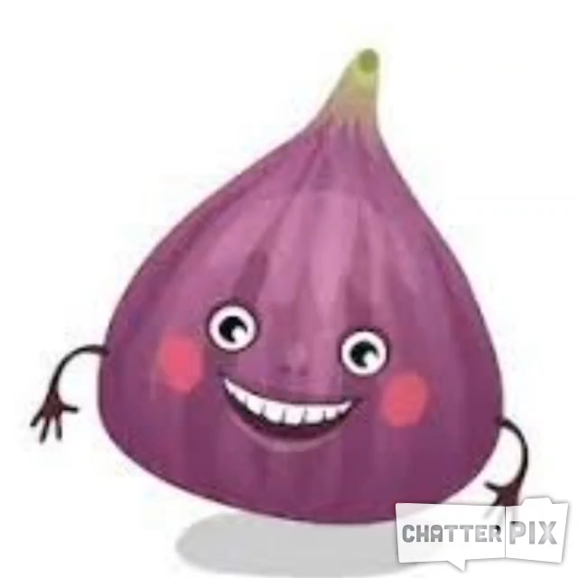
Lesson Plan 1: Fruitboozle
After the trip teacher asks students to introduce the fruit they saw by using chatterpix

Slide 8
Lesson Plan 2: Barnboozle
Teacher asks students What they know about farms , farm animals and their houses. They talk about barns and their building systems. (how animals sleep in them, how they feed themselves, what they eat, how they eat)
Students can bring their animals’ toys

Slide 9
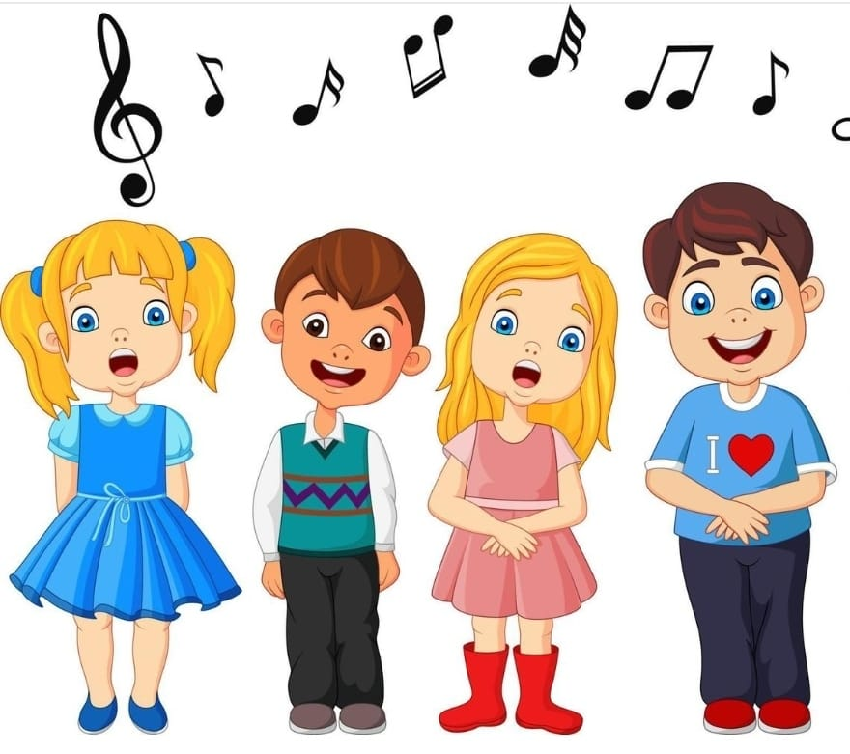
Lesson Plan 2: Barnboozle
Students sing the song
https://www.youtube.com/watch?v=Wm4R8d0d8kU

Slide 10
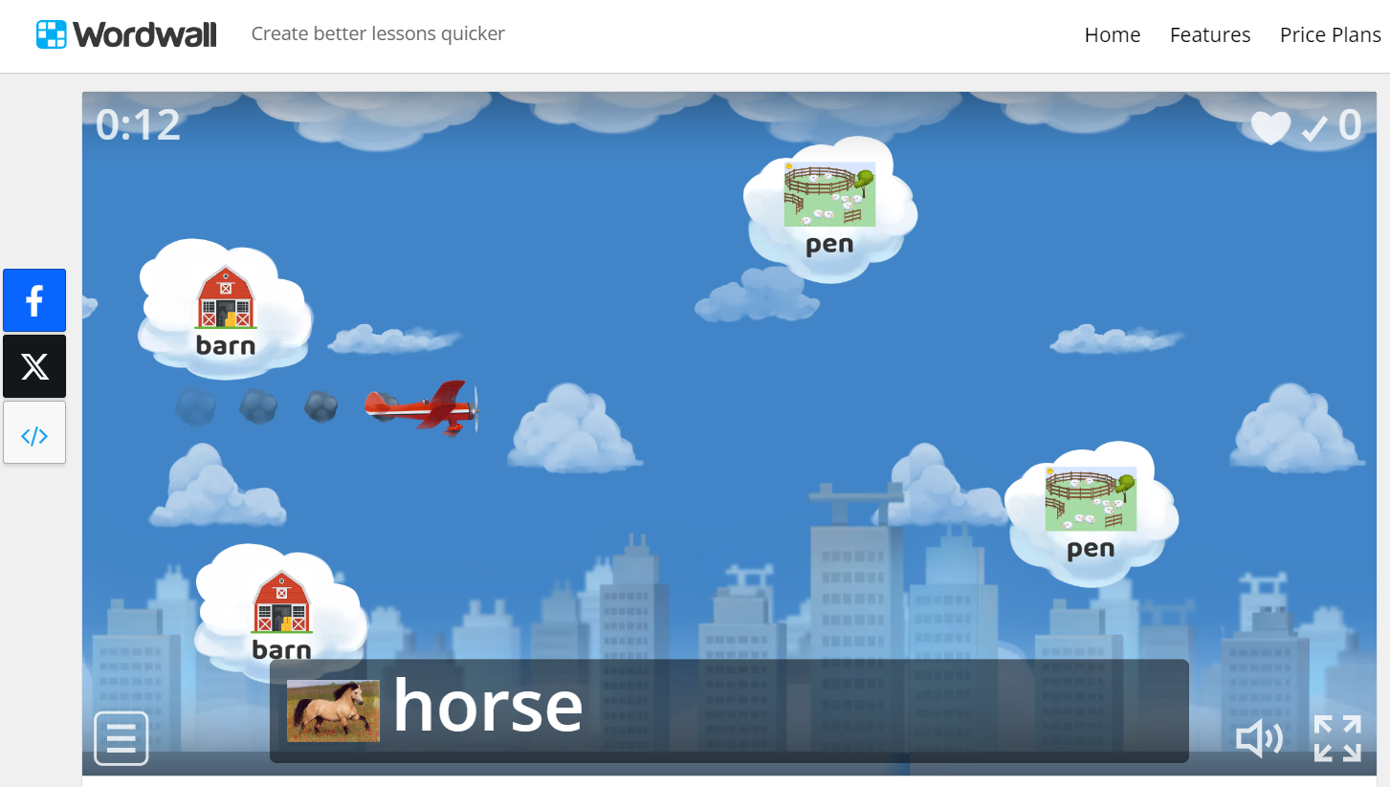
Lesson Plan 2: Barnboozle
https://wordwall.net/resource/9447978/where-do-animals-live
Students play the game before the farm trip.

Slide 11
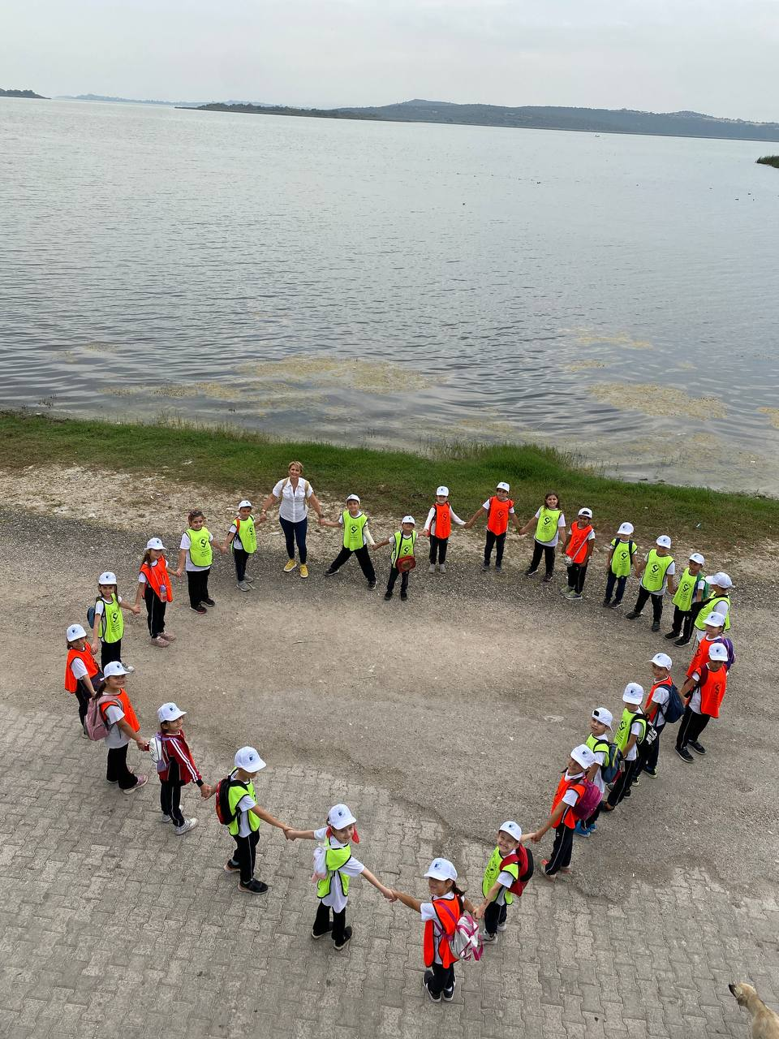
Lesson Plan 2: Barnboozle
Teacher takes students to a farm nearby.
https://wordwall.net/resource/9447978/where-do-animals-live
https://www.baamboozle.com/game/1786766

Slide 12
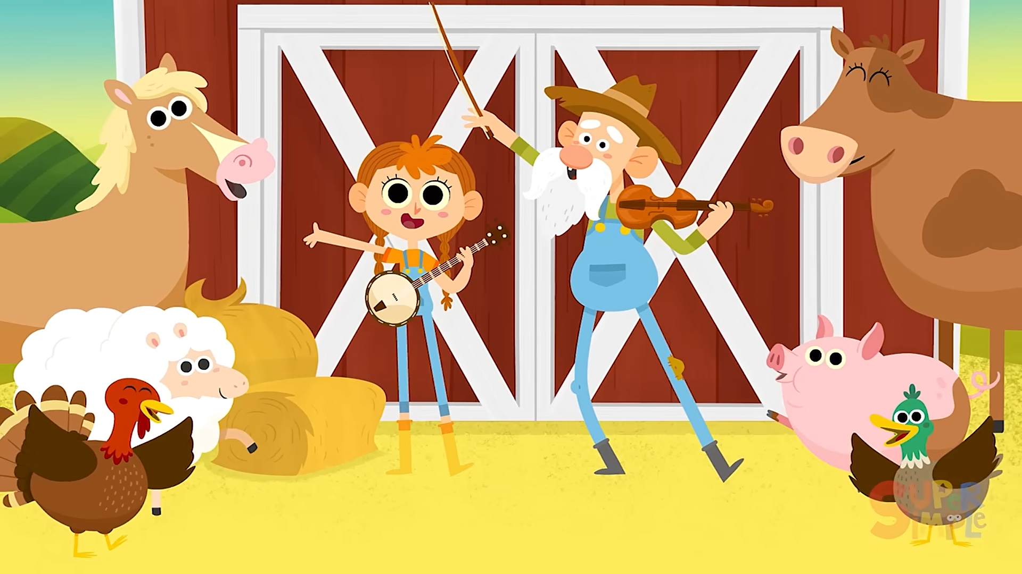
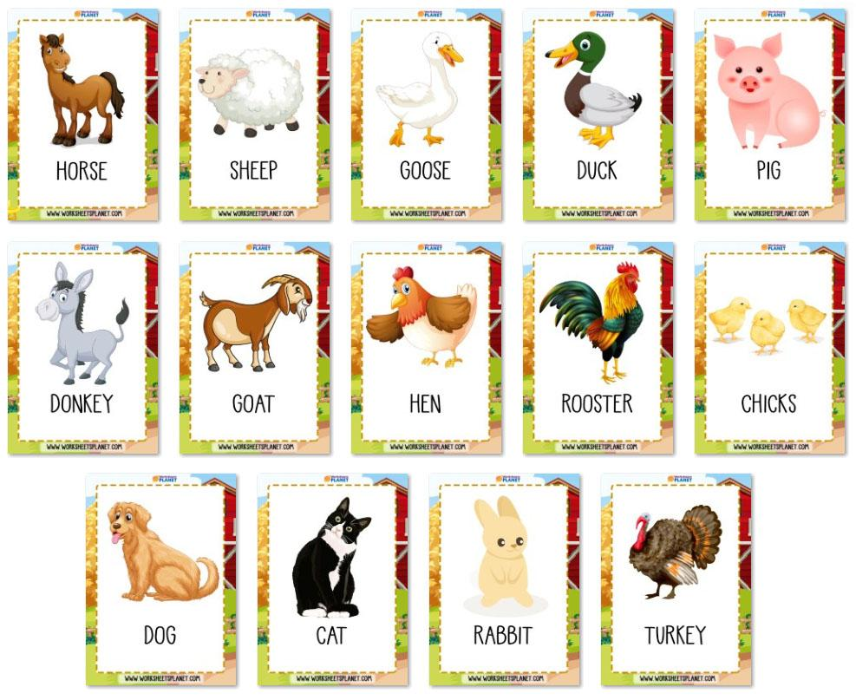
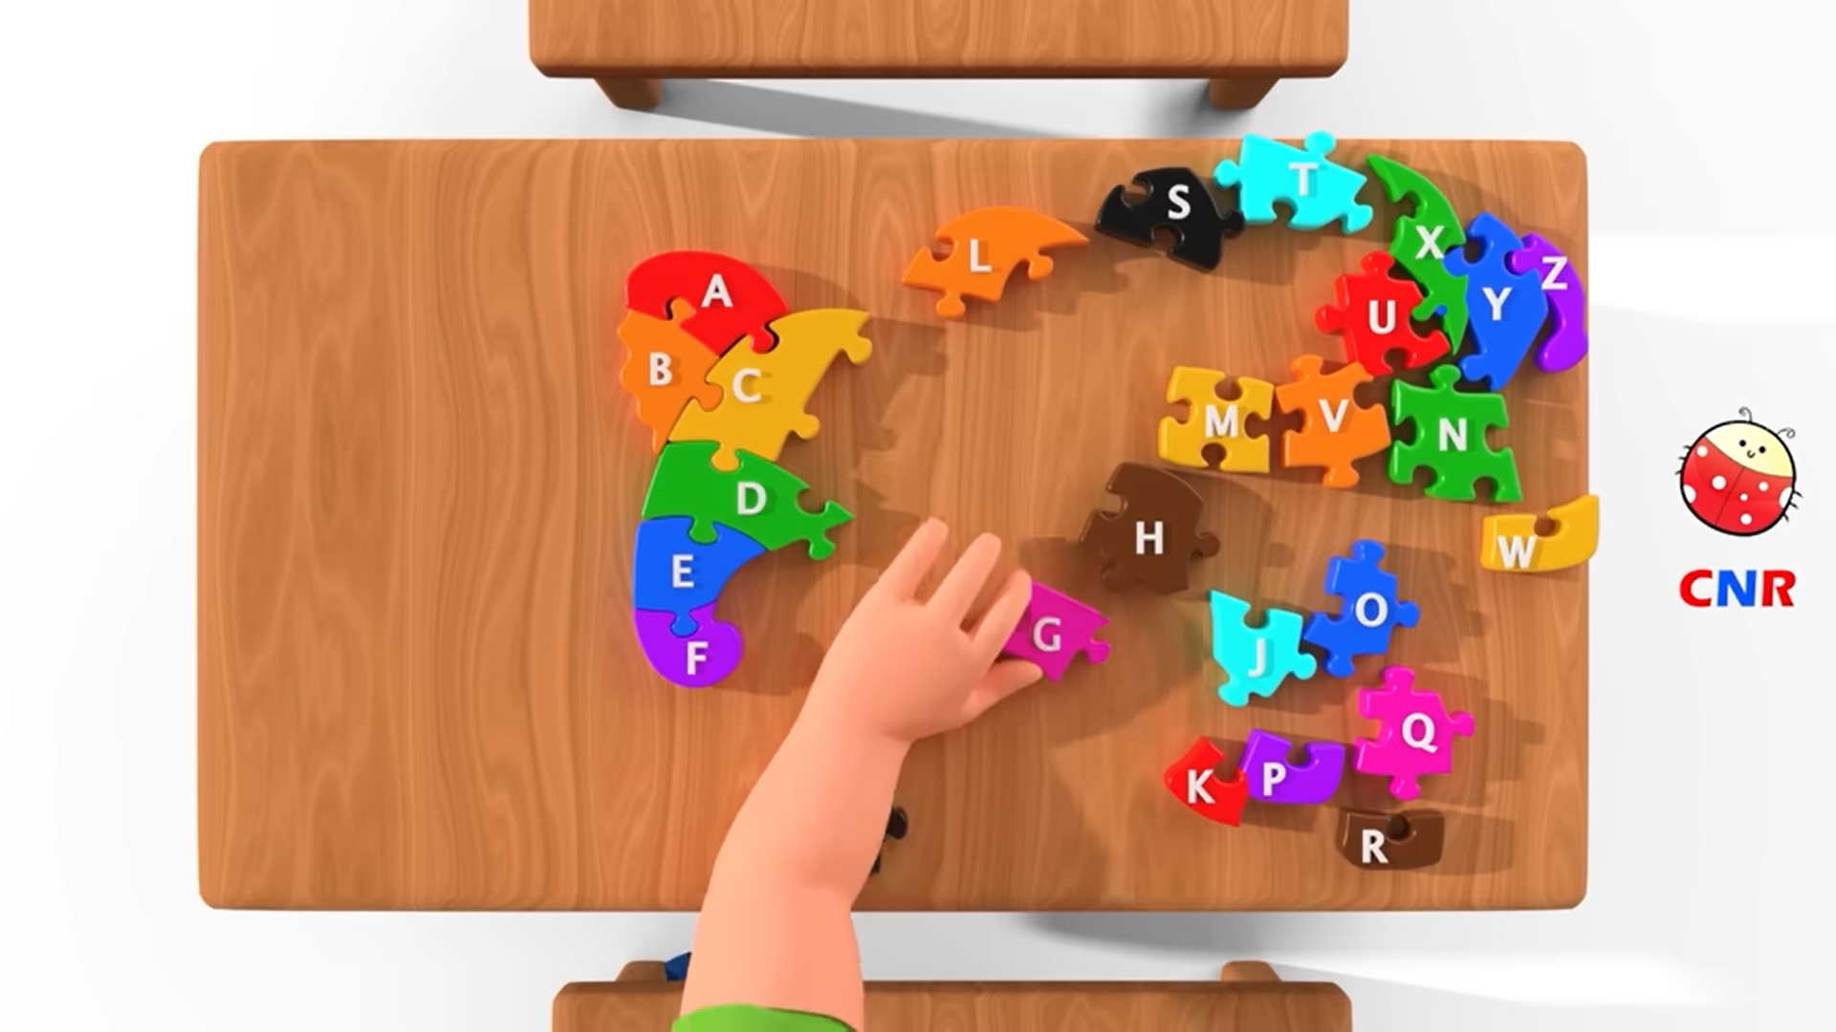
Lesson Plan 2: Barnboozle
Materials:
Animal flashcards
Animal songs
Videos

Slide 13
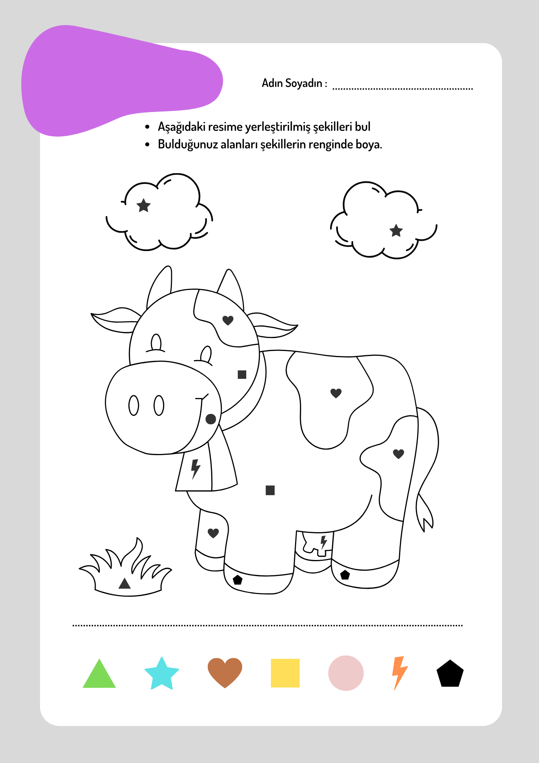
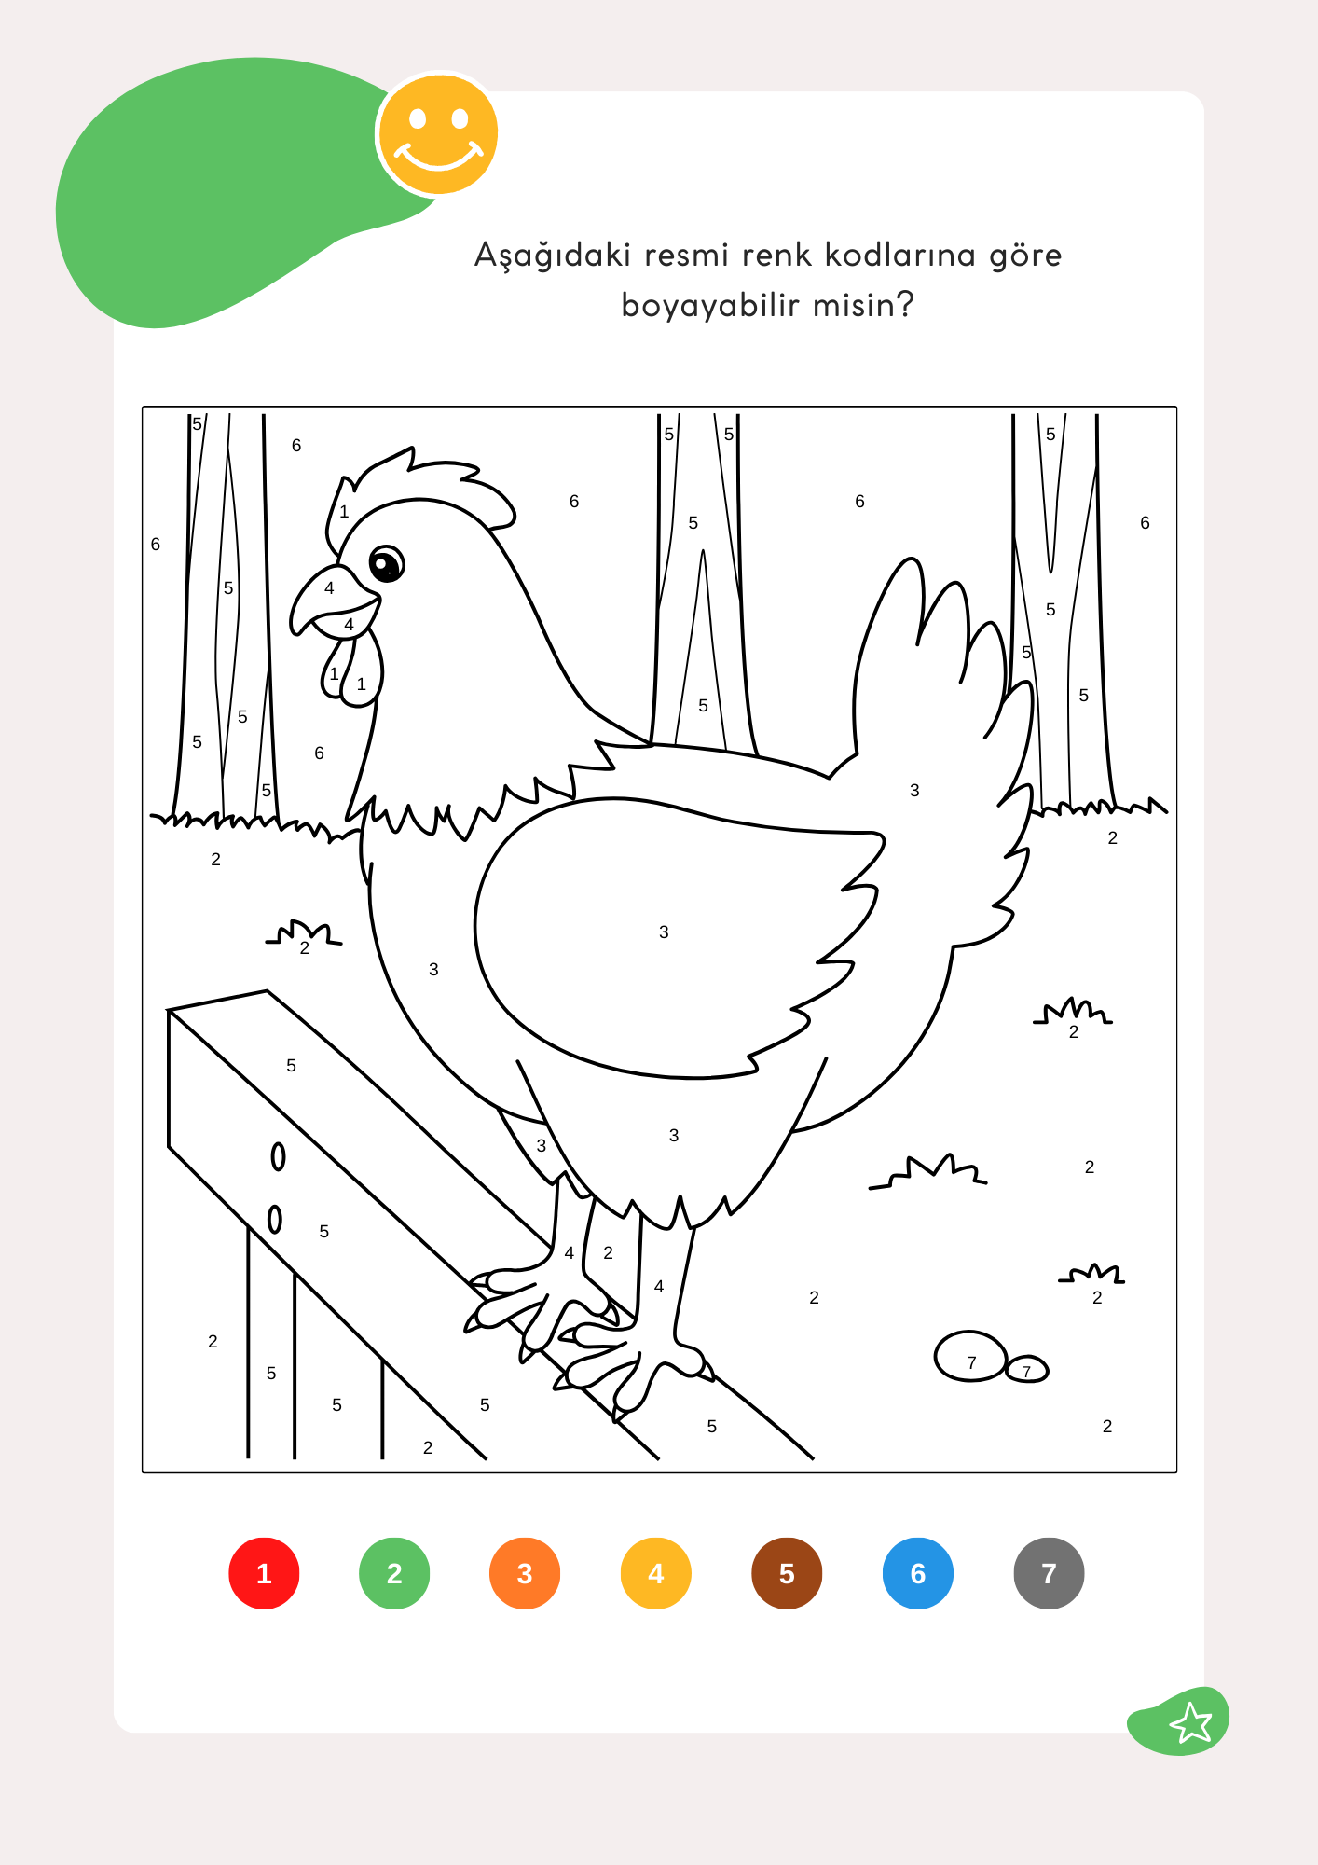
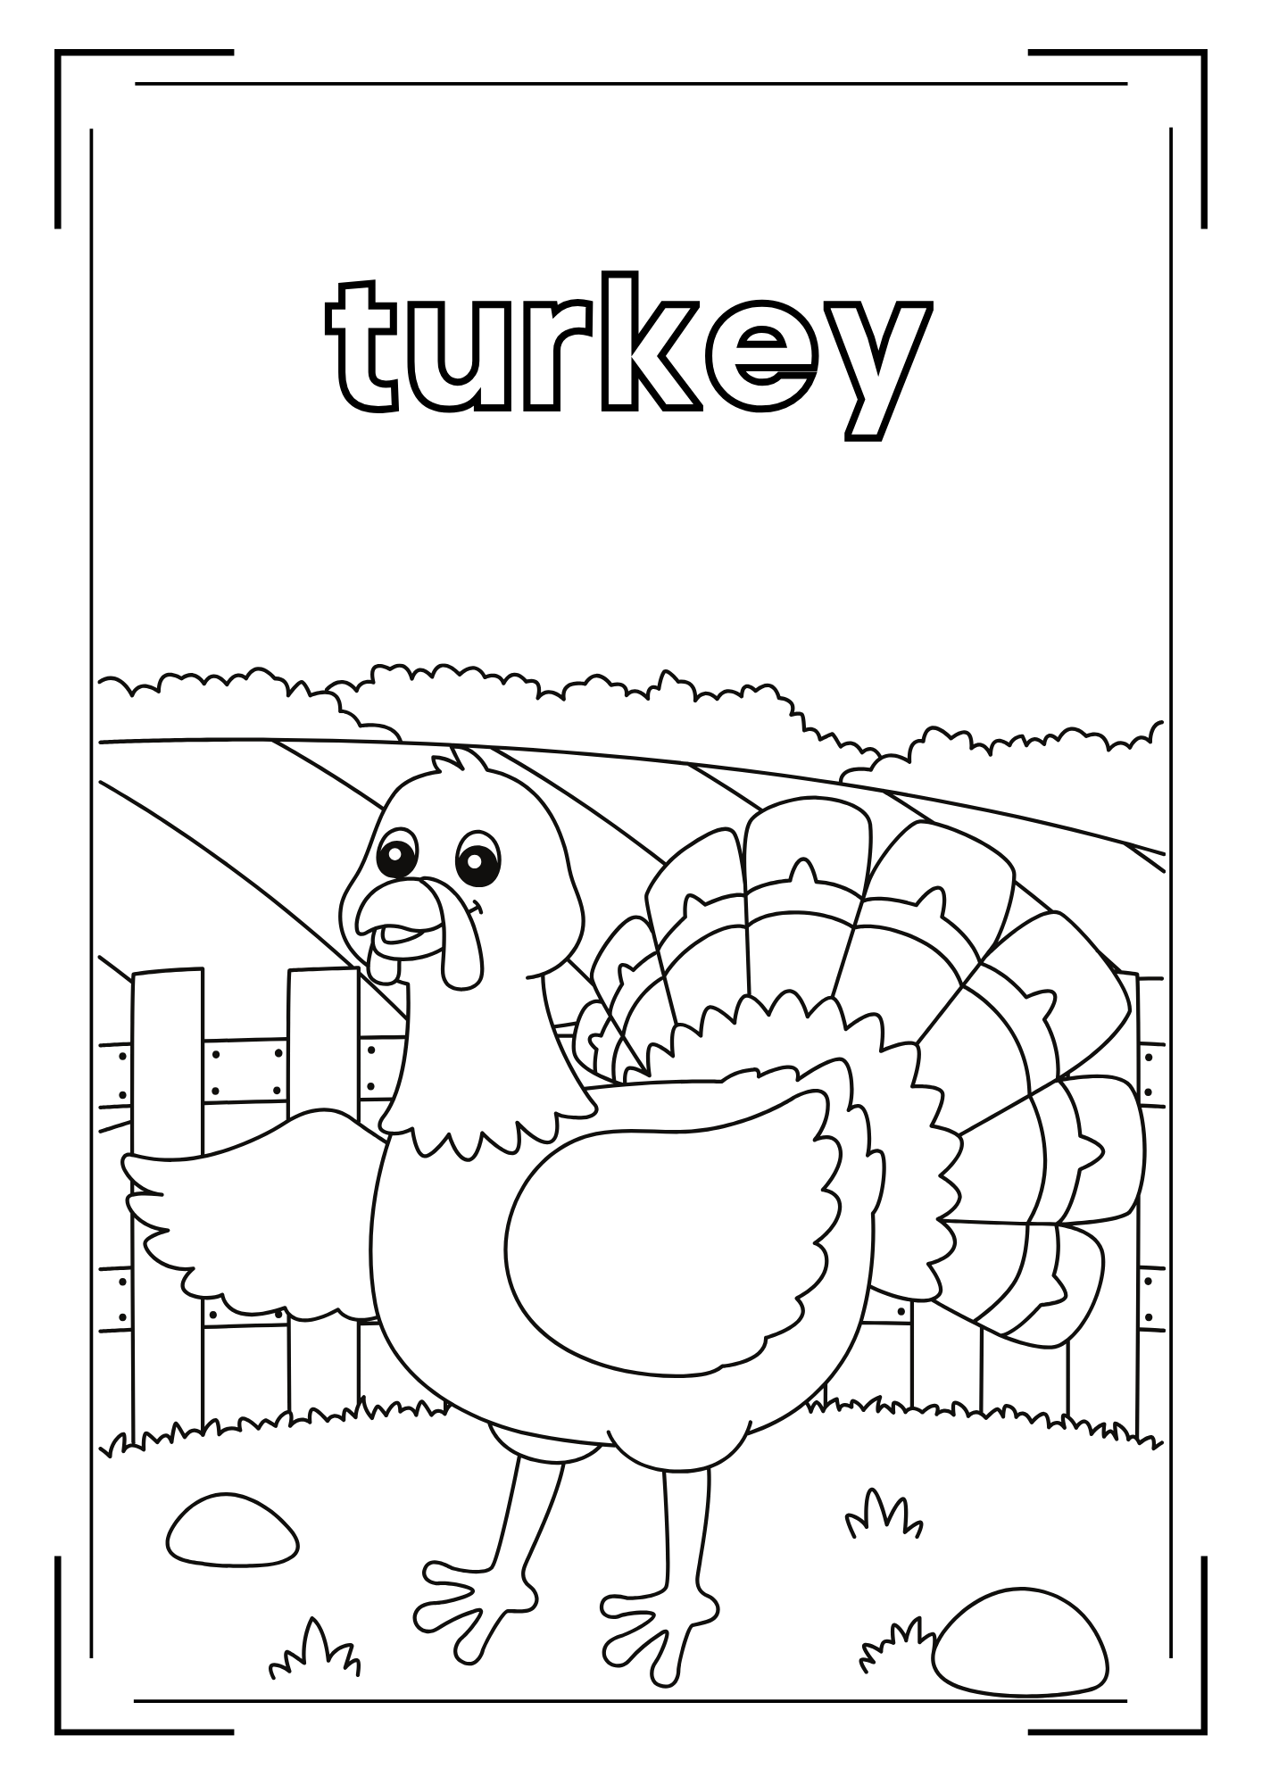
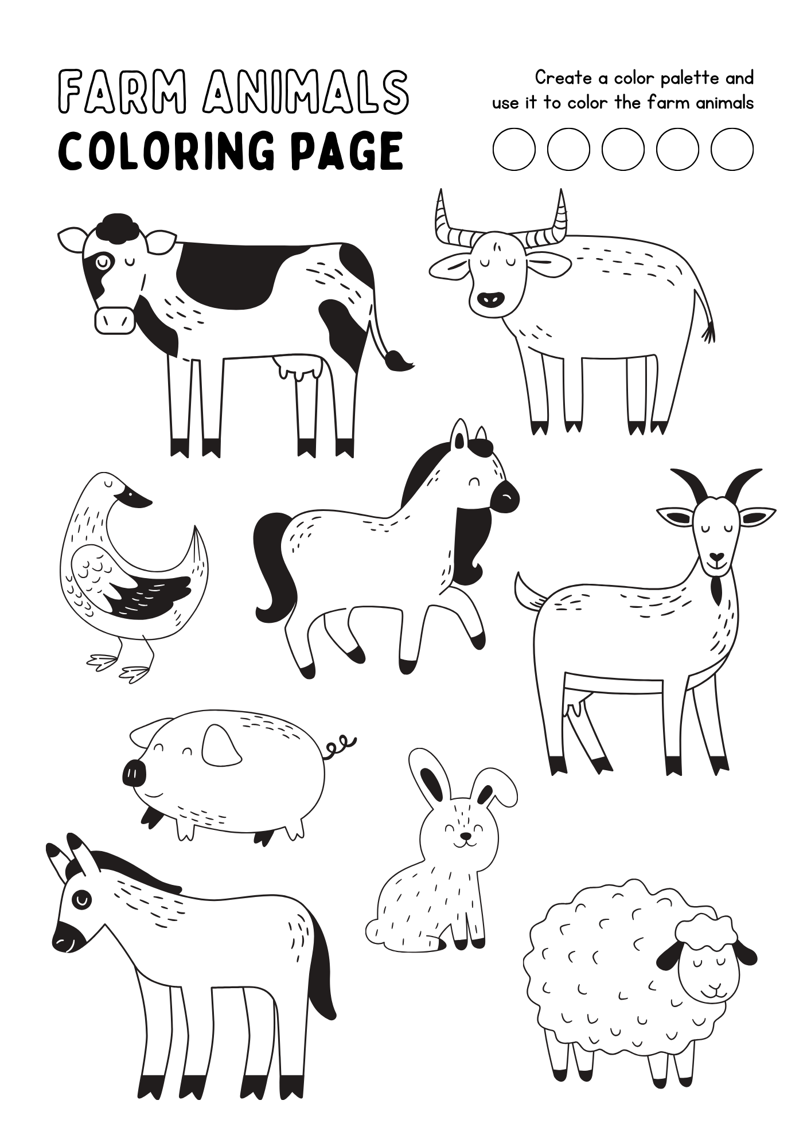
Lesson Plan 2: Barnboozle
Drawing papers
Colouring pens
Animal toys

Slide 14
Thank you for your attention!
Module 3
Gamification in Farm with WEB 2.0 Tools
OMEM
Co-funded by the European Union. Views and opinions expressed are however those of the author(s) only and do not necessarily reflect those of the European Union or the European Education and Culture Executive Agency (EACEA). Neither the European Union nor EACEA can be held responsible for them.

