Slide 1
Module 6 Case Analysis for Ecological Problems in the Farm
Presented by
Szkoła Podstawowa z Oddziałami Dwujęzycznymi nr 20 im. Jana Gutenberga Fundacji Szkolnej w Warszawie
Date: 03/10/2023

Slide 2
Purpose / Learning objectives
LESSON PLAN 1: Water Cycle
After successful completion of the lesson, students will be able to:
Define water cycle
List, label, and explain the major processes of the water cycle
Evaluate the importance of the water cycle for living organisms
Investigate the relationship between temperature and rate of evaporation
Discuss the role of plants in the water cycle
Explain how the natural water cycle works using multiple medium
Explore how we interact and manage the water cycle to meet our needs

Slide 3
Intersecting objectives
agricultural efficiency
the problem of hunger and malnutrition
overdrying of soils

Slide 4
Facilitation
The school provides the materials and conditions for the experiments.
The teacher has presentations, films, animations. There is a large blank poster – wonder wall in the classroom where pupils can write down answers to questions, ideas, suggestions.

Slide 5
Ideas for follow - up
The knowledge gained during the activities about the water cycle is intended to encourage pupils in the key challenge of saving water. The application of the skills learnt should target two aspects. The first is to slow down water in surface run-off and the second is to reduce water loss through surface evaporation.
One day maybe you will change the world! Design your own models and implement solutions. Take care of the water. Without it there is no life

Slide 6
Resources required
Smartboard with Internet access
Water Cycle | How the Hydrologic Cycle Works - YouTube
Water Cycle Song - YouTube
Make a cloud experiment - YouTube
Water evaporation experiment – YouTube

Slide 7
Source / The day of the lesson: Materials & Class preparation
https://www.sydneywater.com.au/
Scissors
Poster paper
Blank cards
Sticky tack or tape
Markers
Colouring pencils
Make a cloud demonstration
1 x Large glass jar with a metal lid
Boiling water
Blue food colouring
Ice cubes
Matches

Slide 8
Source / The day of the lesson: Materials & Class preparation
Water evaporation experiment (per group)
4 x Glass jars
2 x Lid (or aluminium foil or plastic wrap)
Permanent marker
Ruler
Blue food colouring
Jug of water

Slide 9
Implementation
Background information
Does water really disappear? Is rain new water? How does water get in clouds? Water is a fascinating
and critical part of Earth’s processes called the natural water cycle.
The water we have today, is all that we have. It’s the same water that existed on Earth billions of years ago. It is used and re-used as it continuously moves from the Earth to the atmosphere and back again.
During its journey through the cycle, water changes states as it falls as rain, snow, sleet or hail (precipitation). Water is heated by the sun, evaporates into the atmosphere as water vapour, condenses into tiny droplets and forms clouds (condensation). Eventually, it falls back to earth. Water seeps into the ground (infiltration) and moves slowly as groundwater (percolation) to nearby lakes, streams or oceans. Some groundwater is taken up by plants, travels through plants and evaporates back into the atmosphere as water vapour (transpiration) and the journey begins again.

Slide 11
Instructions step by step
Pre-activity (10 min.)
Inquiry question: What are the processes of the natural water cycle?
Explore how water moves from the Earth to the atmosphere and back again and the stages of the natural water cycle. Pupils come forward to answer and express themselves

Slide 12
Activity 1: Wondering about water (20 min.)
Let students reflect on the following questions.
Have you ever wondered…
Does water disappear?
Have you ever seen a puddle dry?
Where did the water go?
How are clouds made?
How does water get in clouds? Is rain new water?
How does water move from the Earth to the clouds and back?
Either the teacher or students record statements and questions on cards and place on the wonder wall.
Throughout the lessons, encourage students to reflect, ask questions and look for questions that have been answered. Use a word wall to capture any new vocabulary.

Slide 13
Activity 2: What is the natural water cycle? (30 min)
1.Using Background information, introduce and explore the natural water cycle and capture the vocabulary on the word wall. Prior learning: water can change states and exist as liquid, solid or gas.
2. Sing and act out the Water Cycle Song - YouTube. The song can be repeated throughout the lessons.
3. Watch the Water Cycle Video – on Youtube.
4. Students complete the Natural water cycle worksheet.

Slide 14
The water cycle adventure play
Use the ‘Water cycle adventure play script’. The play follows the adventures of two water drops as they pass through the water cycle. Make copies of the play, assign roles and read the play in class. After reading the play, students could illustrate the journey of the water drops through the water cycle.

Slide 15
Water cycle experiments
Demonstration – Can you make a cloud? (30 min)
Preparation:
Using the Make a cloud brochure, prepare your materials for a class demonstration. Watch the Make a cloud experiment video to see how it’s done.
Demonstration:
1. Using the PowerPoint as a prompt, ask students to discuss as a class or in pairs:
• What are clouds? How are they made? What are they made of? Why does rain fall from clouds?
• Can you make a cloud?
2. Recall the water cycle by singing the Water Cycle Song.
3. Perform the demonstration with your students.
4. Using the See, think, wonder worksheet students record their thoughts. Ask students prompting questions:
• What happened? Why?
• Why did we warm the water? What makes water warm on Earth?
• Why did we use ice cubes?
• Why did we see condensation, a cloud?
5. Watch the Make a cloud experiment video and use the PowerPoint and Discussion notes to help answer some of their questions and describe what happened. Students can revise their worksheet if needed.

Slide 16
Practical investigation – Does water disappear? (30 min)
Preparation:
Using the Water evaporation experiment brochure prepare your materials for two sets or more. Watch the Water evaporation experiment video to see how it’s done. Note: The results of this experiment will take a few days.
Practical investigation:
1. Watch the Water Evaporation Experiment video. Ask students to reflect on these questions:
• Does water disappear?
• Why are there jars, one with a lid and one without a lid?
• What changes will we see? How can we compare the differences?
2. Display the Plan an investigation template in the PowerPoint to help students think and work like a scientist.
3. Record students’ predictions, materials, risks and safe choices to conduct the investigation.
4. Set up a set of jars or multiple sets, placing one set in a windowsill with sunlight and one set in the shade. This will help with the concept of heat or sunlight driving evaporation.
5. Ask students to predict which one they think will evaporate most.
6. Use the Measure and compare worksheet for students to record observations over several days.

Slide 17
Practical investigation – Does water disappear? (30 min)
7. Discuss their findings in the Measure and compare worksheet.
8. (Optional) Graph the class data to visualise how much water each jar lost and how fast.
9. Record students’ observations, conclusions and questions in the Plan an investigation template.
An alternative experiment is to pour a small amount of water on pavement, some in the shade and some in direct sunlight. Draw a chalk line around each puddle and measure and record how quickly the water evaporates over time.

Slide 18
Optional
Make a water cycle model
Using the Make a water cycle model instruction sheet each student, or in groups, can create their own water cycle in a plastic sandwich bag.
Water cycle terrarium
Make a mini Earth and discover the water cycle in action using the Make a terrarium brochure and Water cycle and terrarium experiment video.

Slide 19
Purpose / Learning objectives
LESSON PLAN 2: Water Conservation
how to collect water?
slowing down the water cycle
prevention of water loss through evaporation
preservation and protection our natural resources

Slide 20
Intersecting objectives
Students will know how:
• to fight with drought by retaining water
• to manage water as a sustainable resource
• to protect the water environment
• to meet current and future agriculture demand

Slide 21
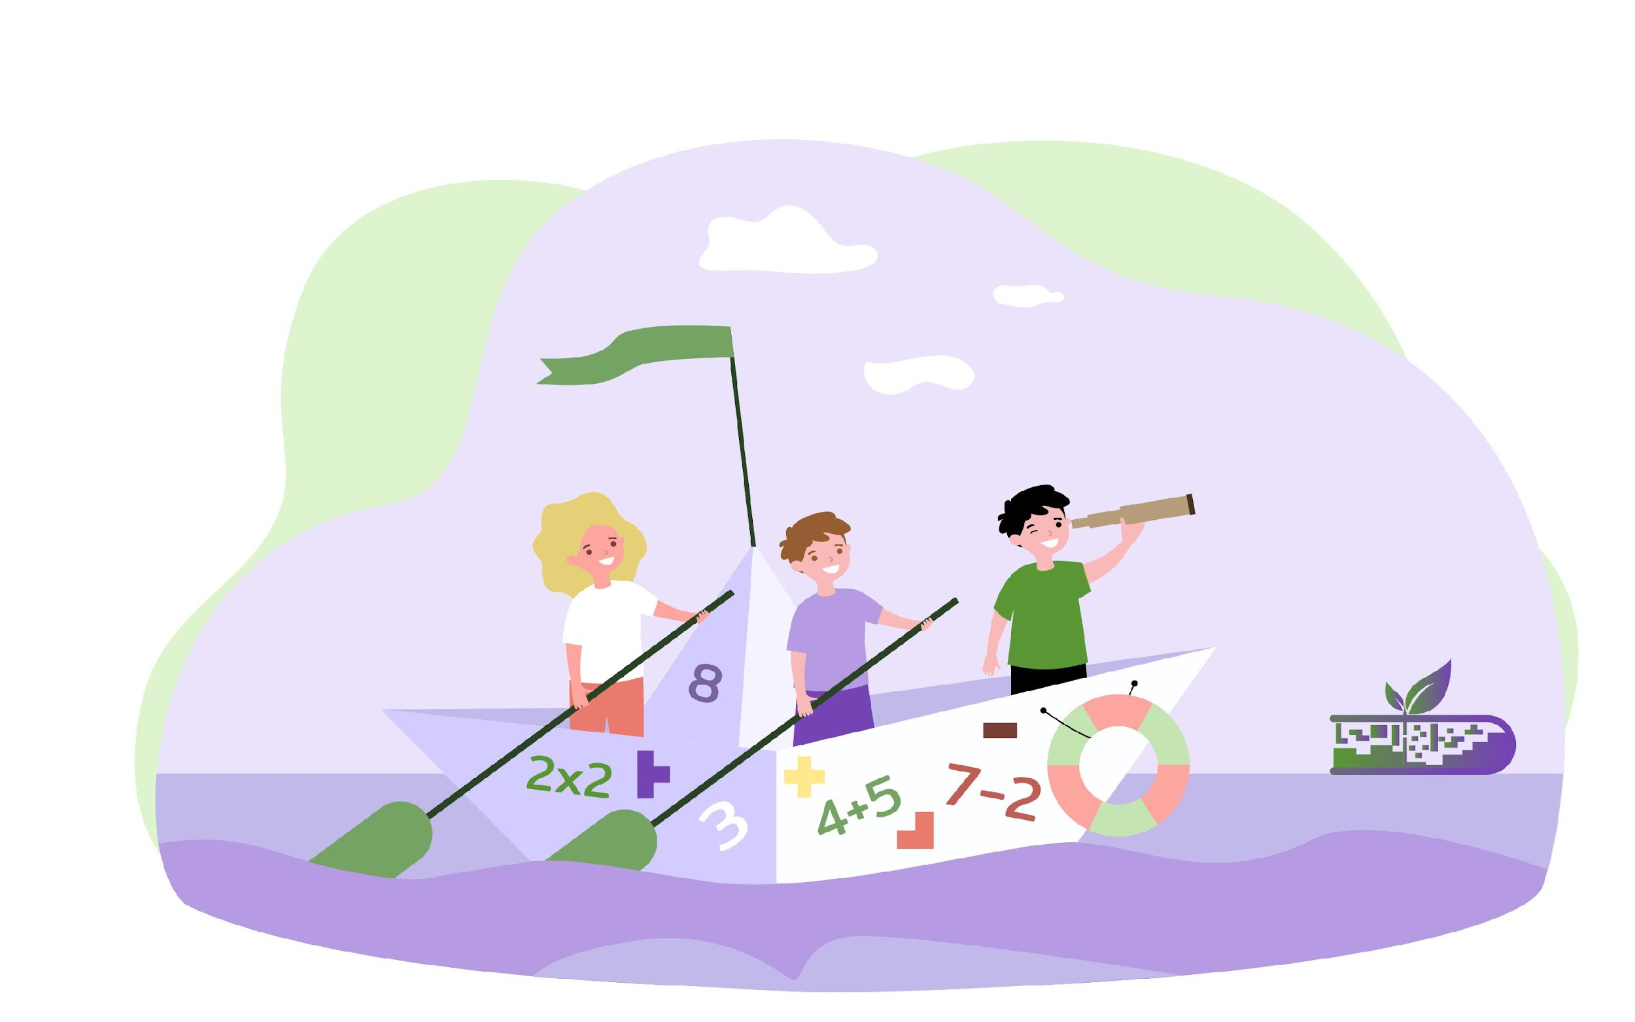
Facilitation
The school provides the materials and conditions for the rain harvesting system and irrigation system model constructions.
The teacher has presentations, films, animations. There is a large blank poster in the classroom where pupils can write down answers to questions, ideas, suggestions.
Students work in a 4 person groups.

Slide 22
Ideas for follow - up
Visit a farm. Ask the farmer how he is dealing with the water shortage. Which irrigation solutions are most effective in his assessment. What are the main problems standing in the way of their implementation?
The problem of water management has accompanied farmers for thousands of years. How did the ancient civilisations of Egypt or China deal with it? Read about it, get information.

Slide 23
Resources required
• Smartboard with Internet access
• Power Point Presentation of different rain harvesting and irrigation systems

Slide 24
Source / The day of the lesson: Materials & Class preparation
Watch video: Holding Water: Working with Nature to Drought-Proof Your Farm - YouTube
Watch video: 4 Tips for Water Conservation in Agriculture - YouTube
Watch video: 💧Best Ways to Collect Rainwater - YouTube
The Self Watering garden: How to Create a Passive Rainwater System with Dr Cally Brennan - YouTube
Drip Irrigation Basics - YouTube
http://thewaterproject.org/rain_catchment.asp

Slide 25
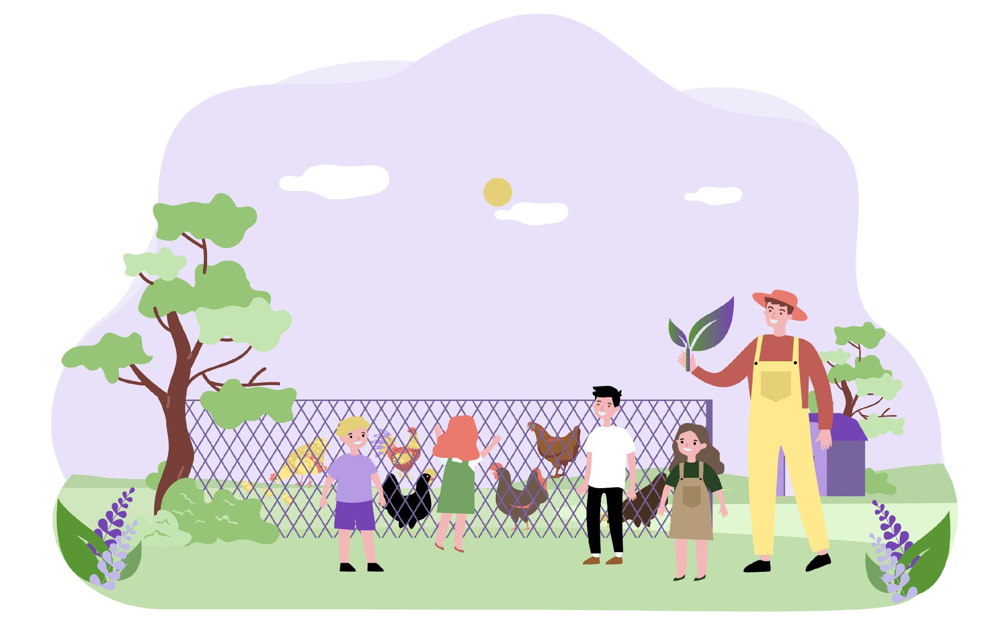
Source / The day of the lesson: Materials & Class preparation
Materials:
drawings/Posters
rainwater catchment surface
conveyance system (pipes)
water storage tank
plastic tubes,
rubber hoses,
straws,
aluminium foil,
plastic wrap,
plastic cups,
knife,
scissors,
wire,
string

Slide 26
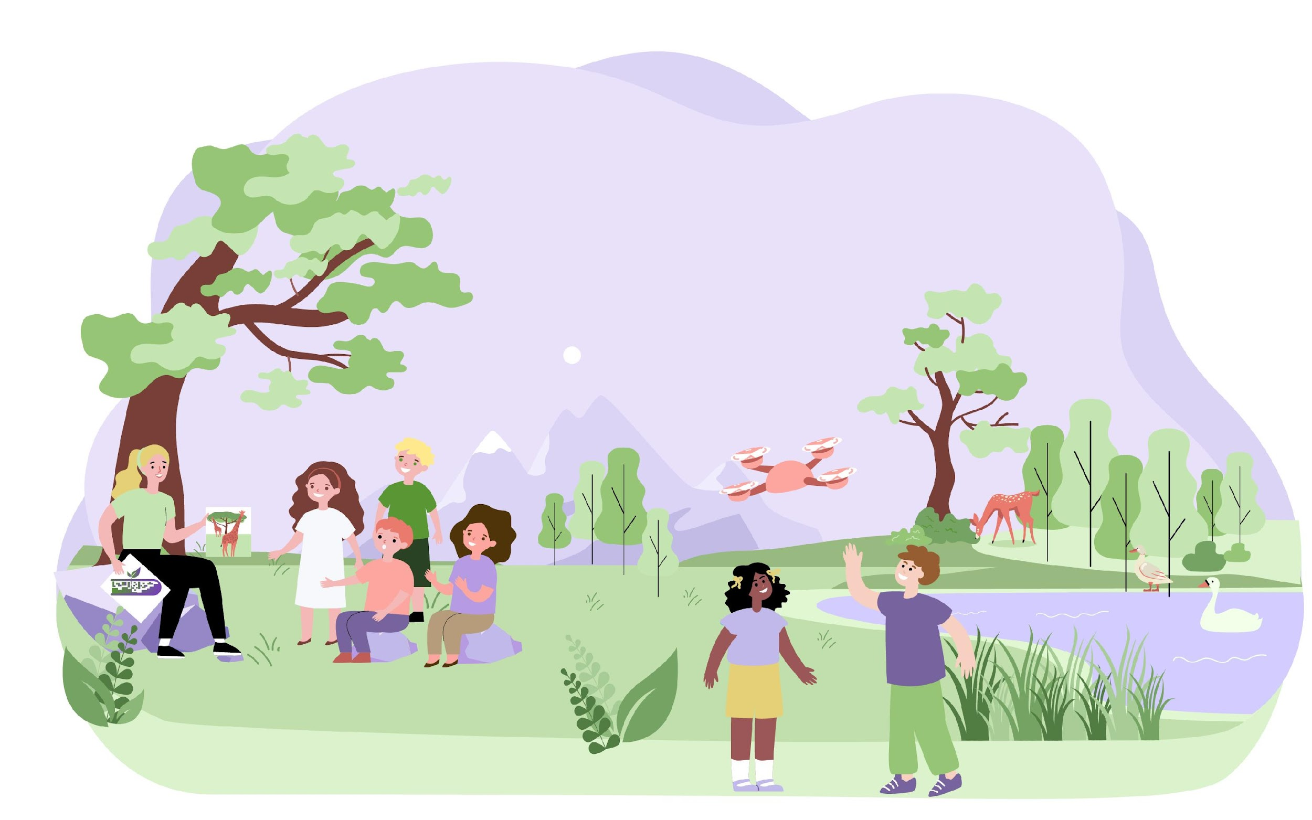
Implementation
Pre-activity (5 min.):
Ask students to list the main sources of water available to farmers. Have them recall the main types of rainfall. Students write their answers on a poster.

Slide 27
Rainfall distribution map (15 min.)
The teacher displays a map of rainfall distribution in Europe on the screen. Selected pupils read out from the map the countries, regions with very little rainfall.
• Ask your students to find the relationship between temperature and evaporation rate
• Facilitate discussion with students about impact of drought
• ask students to think about the possibilities of obtaining water suitable for agricultural purposes
Write your answers, observations on the poster

Slide 28
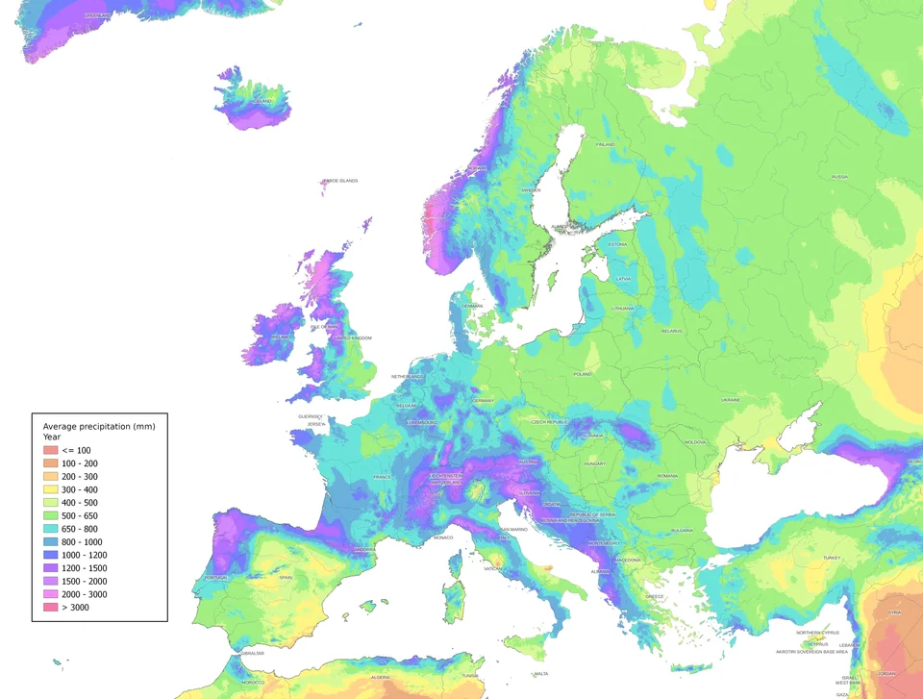
Source: https://external-preview.redd.it/w5GWr82JXHIeXZFSajk-sRmzkjRlj0c1hGt3StA04SQ.jpg?auto=webp&s=8cbaa1439ea33594d4a7102ab3f6b084de74cfcb

Slide 29
ACTIVITIES 20 (10+10) min
Divide students into 4 person groups. Watch sample video materials to get inspired.
STEAM Activity 1. Design your own rainwater harvesting system
STEAM Activity 2. Design your own irrigation system
Pupils design systems by drawing them on cards or using simple graphics software.

Slide 30
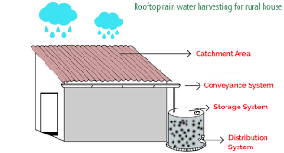
Example design
Rainwater Harvesting for House | Rainwater Harvesting System for House | Top Benefits of Rainwater Harvesting for House (neoakruthi.com)

Slide 31
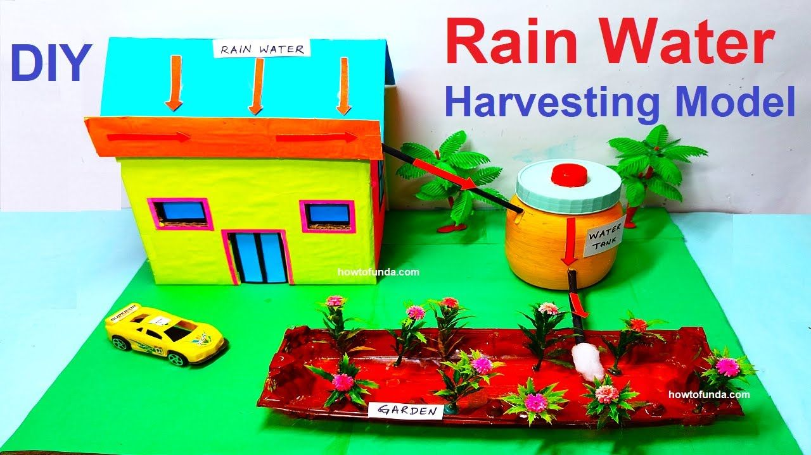
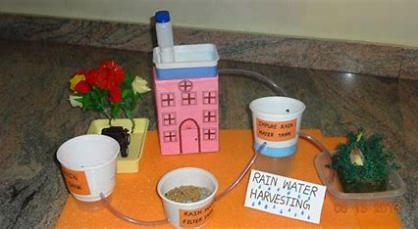
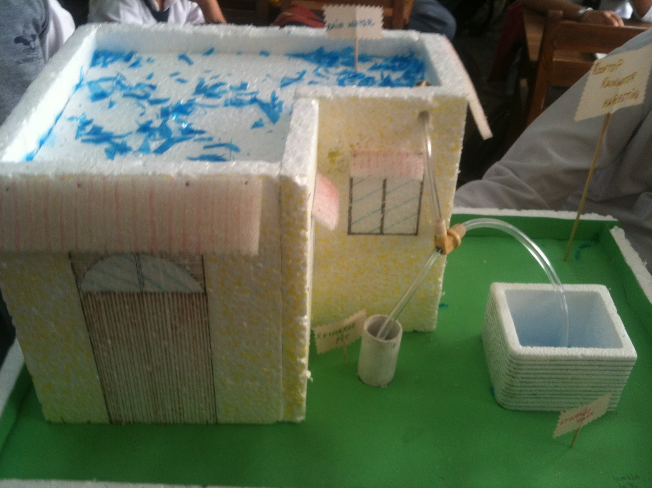
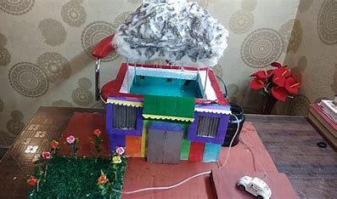
Examples from the internet

Slide 32
ACTIVITIES 40 (20+20) min
STEAM Activity 3. Create a model of a rainwater harvesting system
Each group use available materials to build their own water collection system.
STEAM Activity 4. Create a model of a drip irrigation system
Each group use available materials to build their own irrigation system.
Allow students to make corrections to their work!

Slide 33
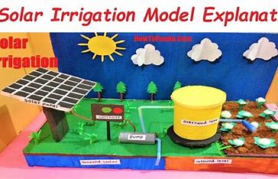
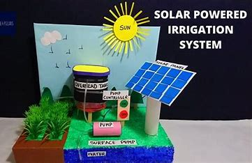
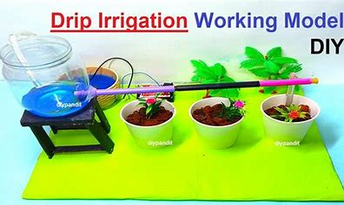
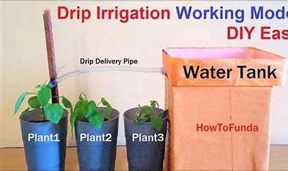
Examples from the internet

Slide 34
PRESENTATION 20 min
Ask group members to present the results of their work
Individual groups show off their constructions.
When presenting the result of their work, students are asked the following questions:
Are you satisfied with the result of your work?
Does the model you have built fulfil its purpose?
Could you make it possible to collect water even more efficiently and to irrigate plants with even less evaporation loss?

Slide 35
Thank you for your attention!
Module 6
Case Analysis for Ecological Problems in the Farm
Szkoła Podstawowa z Oddziałami Dwujęzycznymi nr 20 im. Jana Gutenberga Fundacji Szkolnej w Warszawie
Co-funded by the European Union. Views and opinions expressed are however those of the author(s) only and do not necessarily reflect those of the European Union or the European Education and Culture Executive Agency (EACEA). Neither the European Union nor EACEA can be held responsible for them.

