Slide 1
Module 7 Game-based Needs Analysis for Ecological Problems
Presented by
Osmangazi Municipality

Slide 2
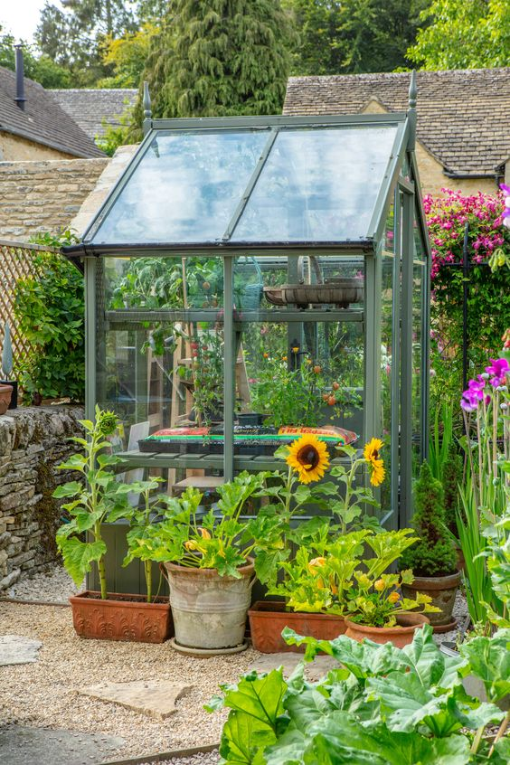
Lesson Plan 1: FEELING THE GREENHOUSE
Purpose / Learning objectives:
Introduce the greenhouse
Importance of greenhouses to meet the food needs resulting from the increasing population and increased consumption.

Slide 3
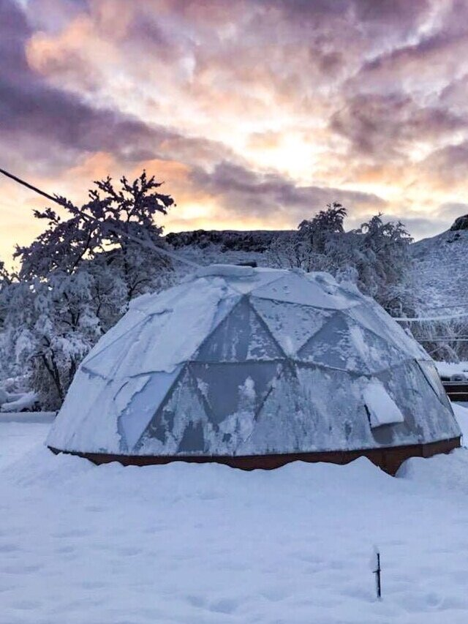
Lesson Plan 1: FEELING THE GREENHOUSE
Intersecting objectives:
To show fruits and vegetables can be produced more efficiently in greenhouses designed to eliminate the climate impact in regions and areas where the climate has a negative impact.
To use arable land to the maximum extent through planned planting while protecting the grown product.

Slide 4
Lesson Plan 1: FEELING THE GREENHOUSE
Facilitation:
Creating the greenhouse in the most efficient way by paying attention to the following factors:
Light
Temperature
Wind
Soil
Direction
Irrigation water supply
Economic activities
Make sure everything is ready and safe before the trip.
Let students get a little dirty in nature, gain experience, and feel nature.

Slide 5
Lesson Plan 1: FEELING THE GREENHOUSE
Resources required:
Vehicle for sightseeing
Greenhouse area
Thermometer
Wooden block/plate/lath/board
Tarpaulin
Small nail or wood staple
Hammer
Soil

Slide 6
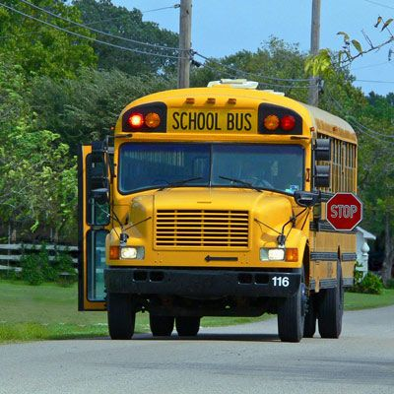
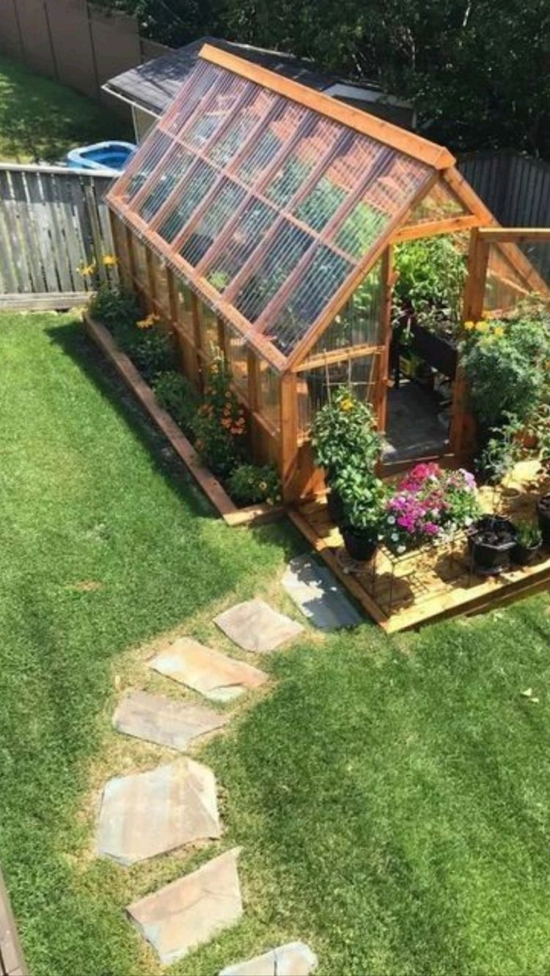
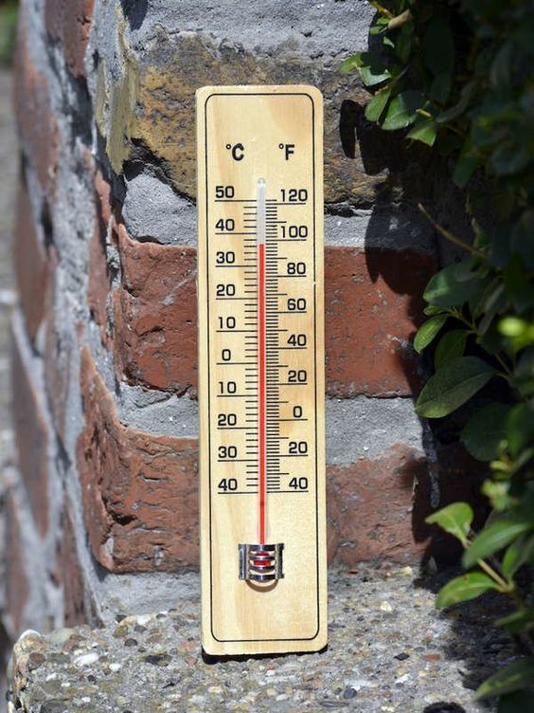
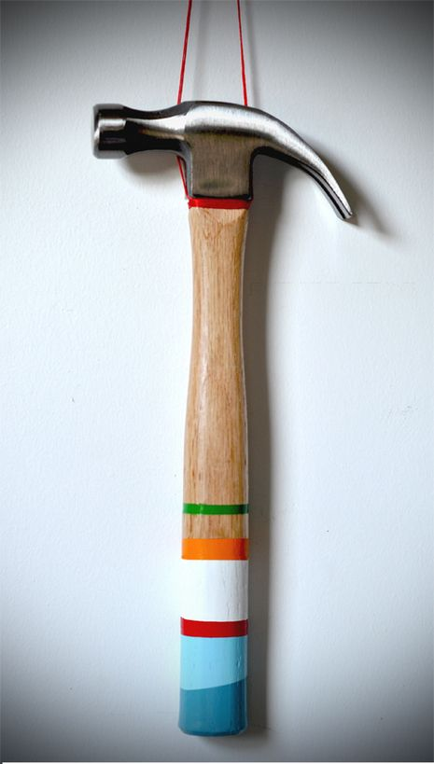
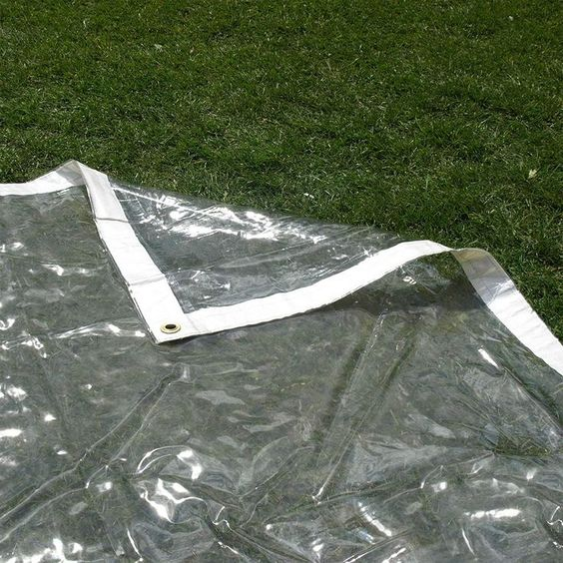
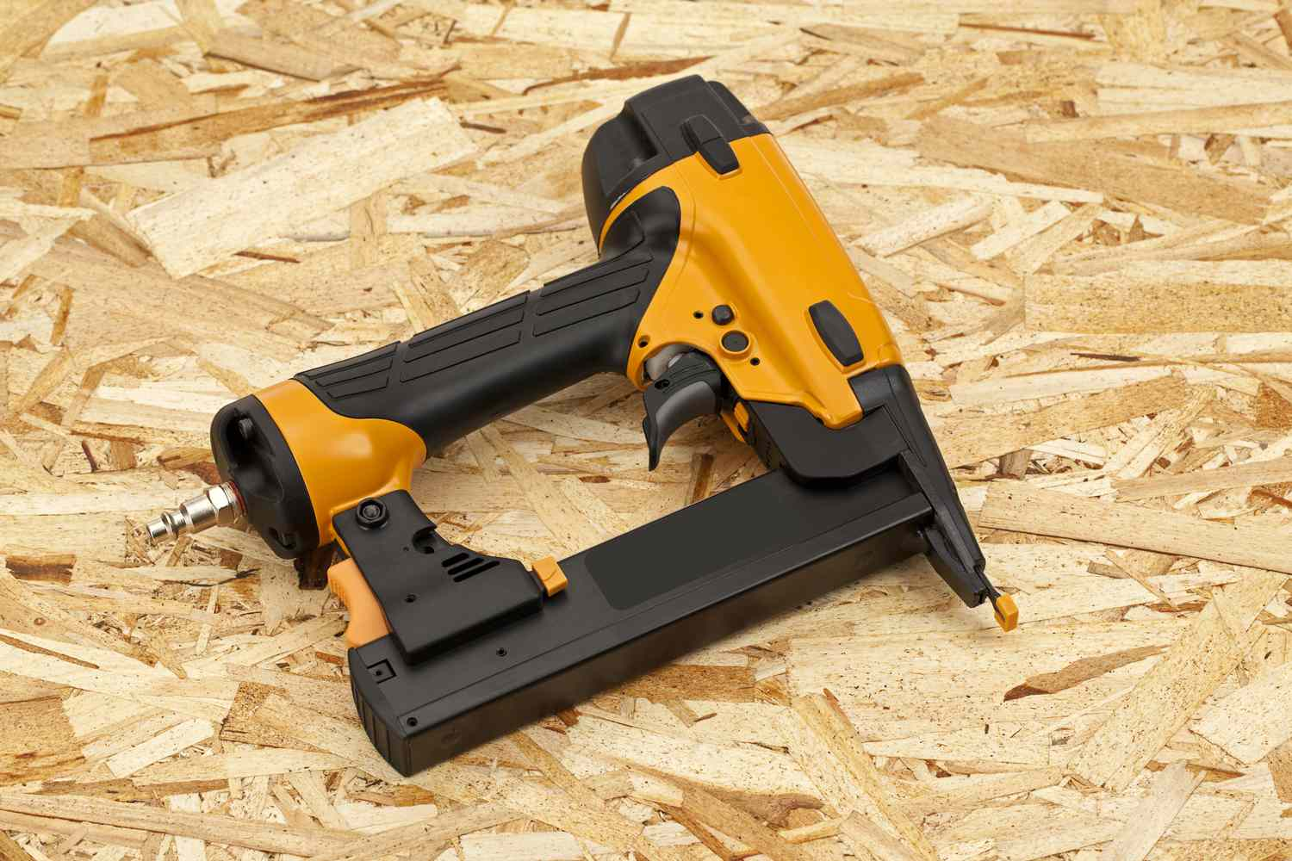

Slide 7
Lesson Plan 1: FEELING THE GREENHOUSE
Implementation
Instructions step by step:
10 min:
After meeting and travel to visit the greenhouse:
«What is greenhouse and greenhouse farming?»
Inform about greenhouses and greenhouse cultivation

Slide 8
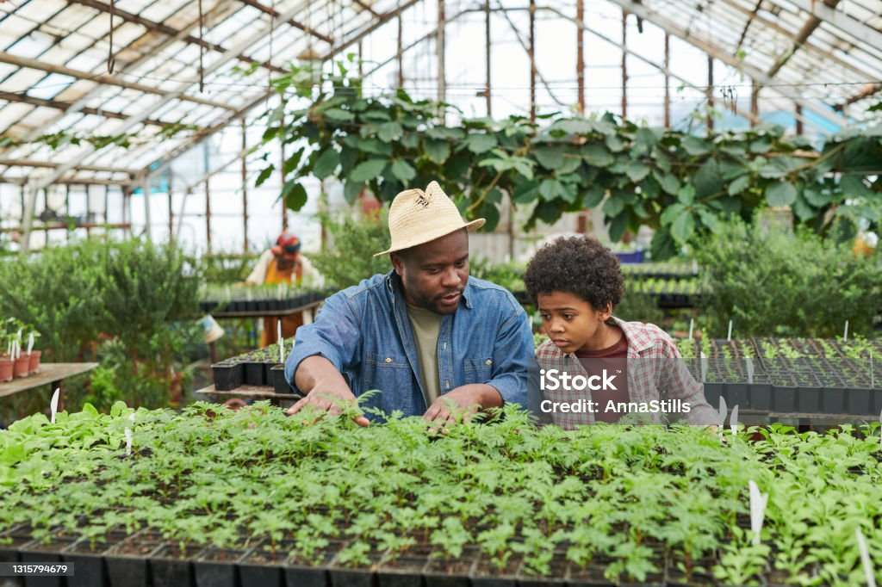

Slide 9
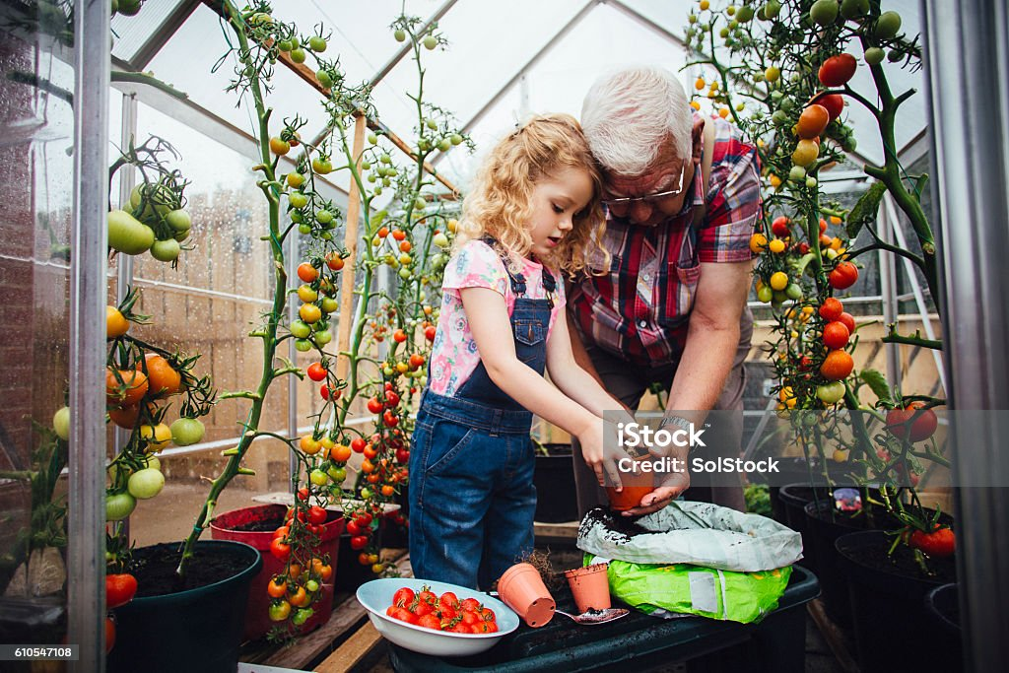

Slide 10
Lesson Plan 1: FEELING THE GREENHOUSE
Implementation: 25 min
Information about the greenhouses and what they do in the greenhouse
Depending on the condition of the greenhouse, students are divided into groups or not. Students are allowed in accompanied by an authorized person
Attention is drawn to the temperature difference and the temperature is measured with a thermometer.
Introduce the products
When going out, attention is drawn to the temperature difference again and the temperature is measured with a thermometer
15 min
Students can taste the products grown in the greenhouse if they are food. If the products are plants or seeds, they are given as gifts to children for examination

Slide 11
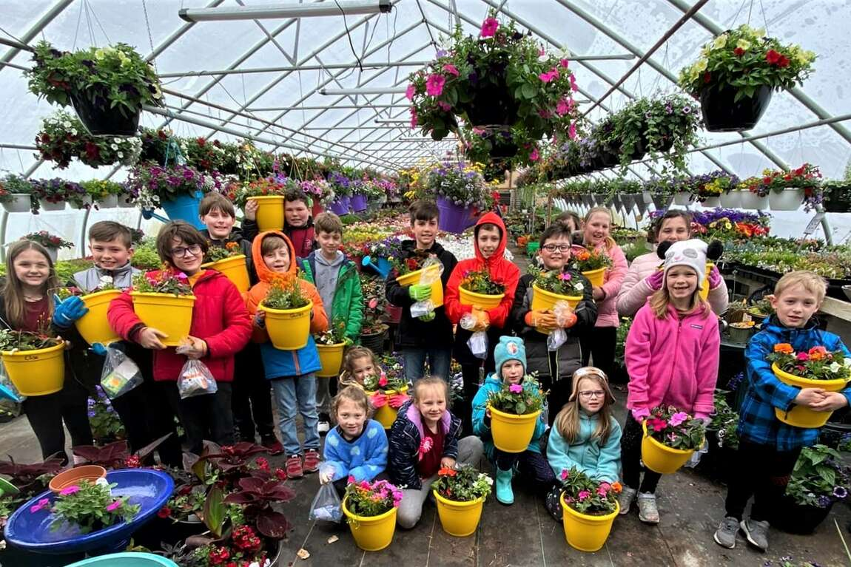

Slide 12
Lesson Plan 1: FEELING THE GREENHOUSE
Implementation:
Hands on activity / farm - based learning: 40 min
***Greenhouse tour and small greenhouse construction
Inform about the factors to be considered in greenhouse installation
Build a small greenhouse with the help of authorized person and teachers
Students are divided into groups and assigned
Create and complete a small greenhouse sample
They return to school with the greenhouse sample

Slide 13
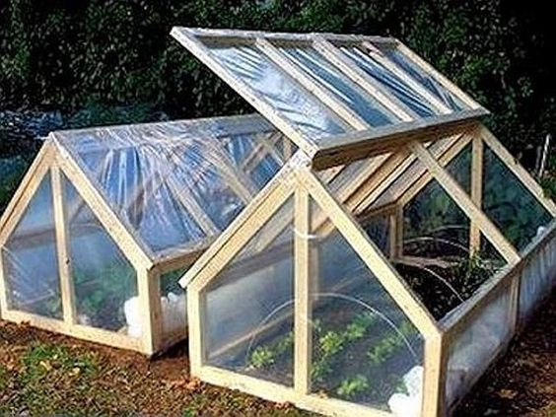
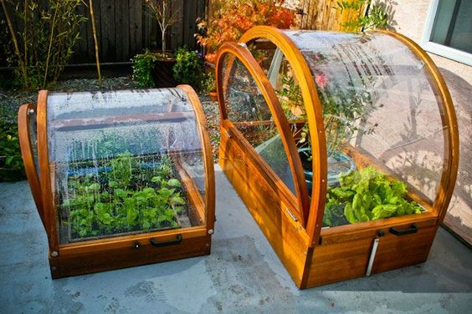
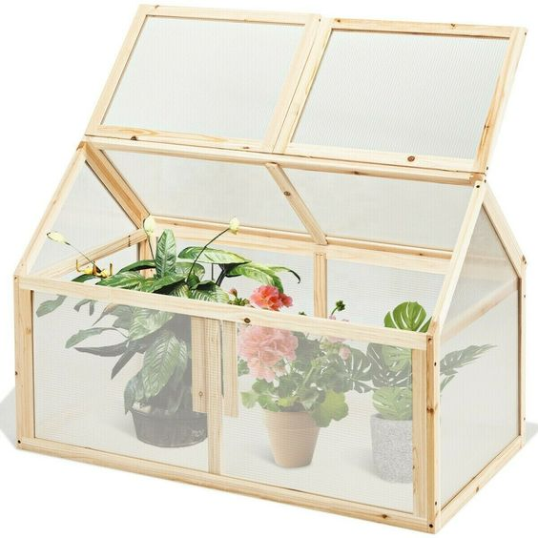

Slide 14
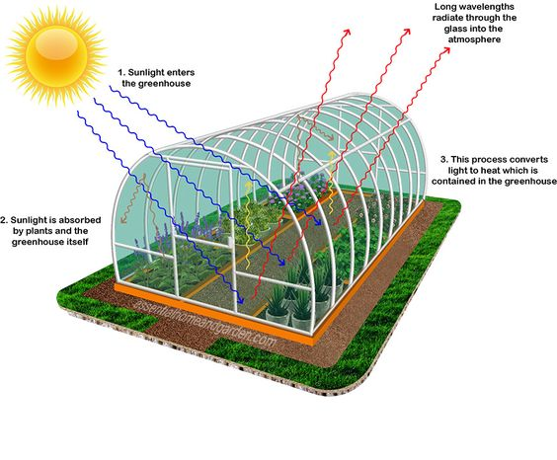
Lesson Plan 2: LITTLE HANDS GREENHOUSE
Purpose / Learning objectives:
Students learn the concepts of greenhouse and greenhouse cultivation
By sprouting seeds in the greenhouse, they assimilate the use of the greenhouse

Slide 15
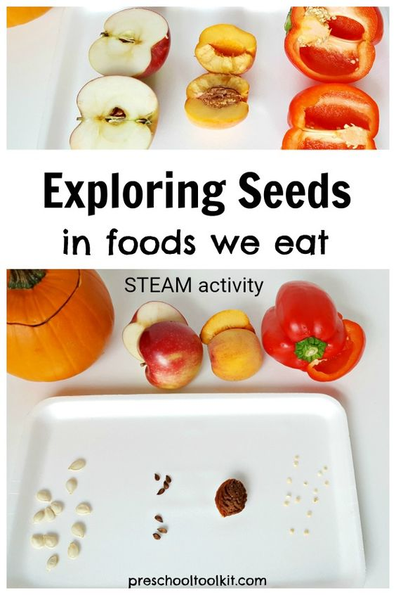
Lesson Plan 2: LITTLE HANDS GREENHOUSE
Intersecting objectives:
They touch on geometry concepts while learning about greenhouse types
They learn about seeds and seed types
They observe the production process of food through the sprouting stage

Slide 16
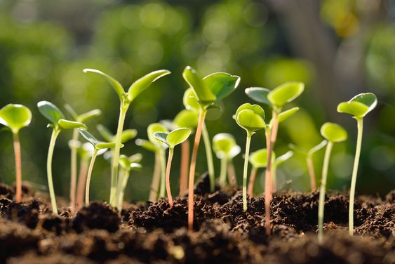
Lesson Plan 2: LITTLE HANDS GREENHOUSE
Facilitation:
When creating a greenhouse, geometric shapes and rules are simply emphasized and seed types are learned and felt.
While students observe the stages of greenhouse production from seed to seedling, they are told the story of how the products they eat come to the table and the labor behind them.
It should be ensured that all materials are ready (internet, soil, etc.) before the lesson.
It should be taken into consideration that the students and the classroom will get a little dirty.
Make sure you always use recyclable or recycled materials.

Slide 17
Lesson Plan 2: LITTLE HANDS GREENHOUSE
Resources required:
Photos
Geometric shape images
Cardboard
Greenhouse model
Plastic bag
Wooden Materials
Seed Types
Bean seed
Glue
Cotton
Cardboard cup or suitable container (recyclable materials can be used, such as toilet paper roll)
Water
Water container or spray bottle
Laptop, smart board etc.
Internet

Slide 18
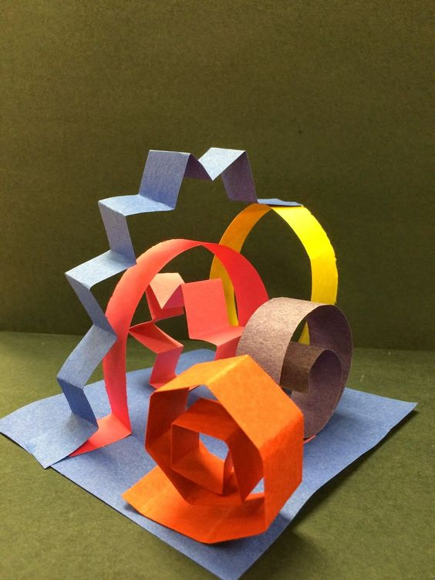
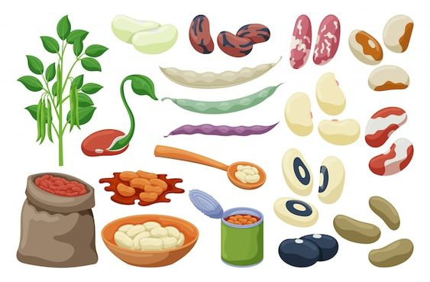
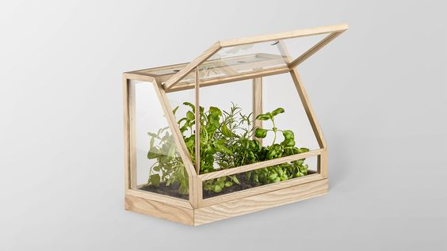

Slide 19
Lesson Plan 2: LITTLE HANDS GREENHOUSE
Implementation
Instructions step by step: 18 min
«What is greenhouse and greenhouse cultivation?»
Inform about greenhouses and greenhouse cultivation
Inform about greenhouse types is given and supported by visuals
Show and discuss geometry shapes and their similarities with greenhouse types
Students are informed about seed types and the seeds brought to the classroom are examined.

Slide 20
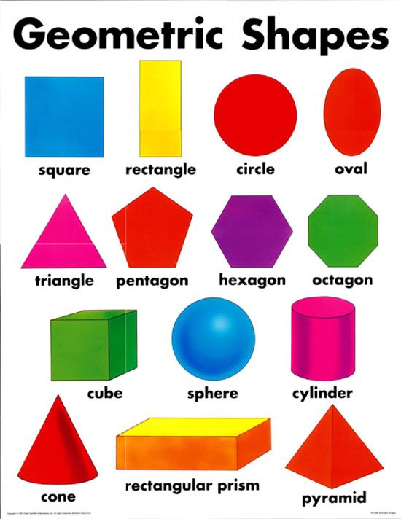
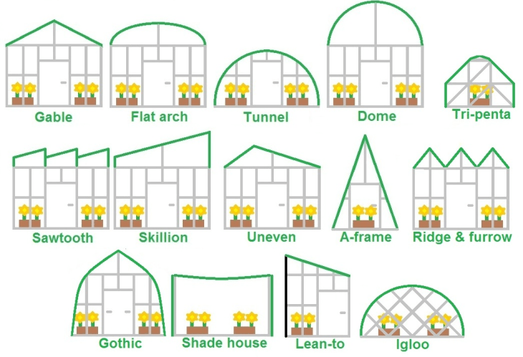
Geometry and Greenhouse

Slide 21
Lesson Plan 2: LITTLE HANDS GREENHOUSE
Implementation
Instructions step by step: 43 min
Divide into sufficient groups to create a greenhouse
Ask to draw first a geometric shape and then a greenhouse using the seeds.
Each group creates a type of greenhouse by using geometric shapes and seeds.
Tell about the types of seeds to be grown in the greenhouse and how they are planted
Students are shown a bean sprouting video:

Slide 22
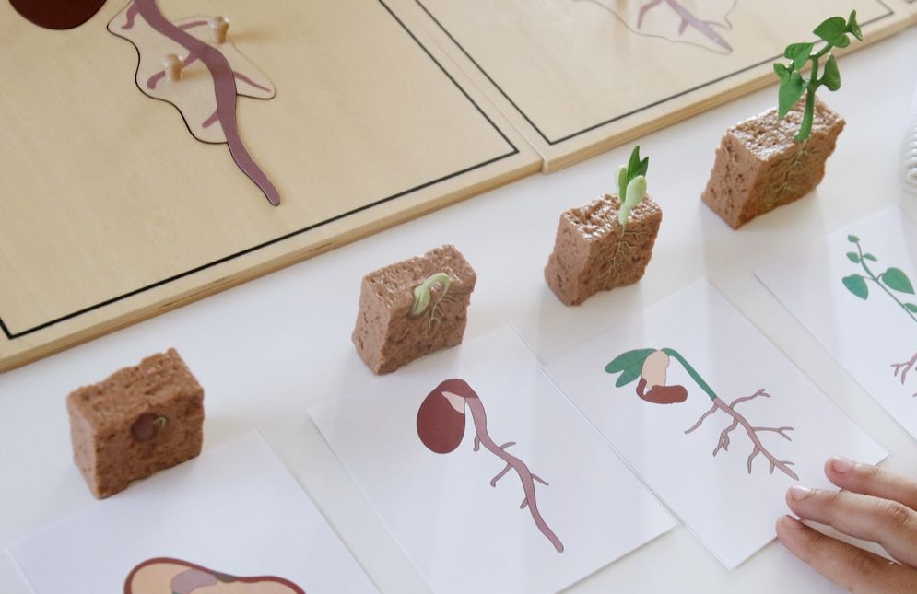
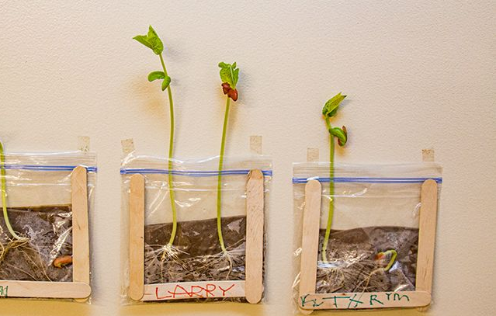
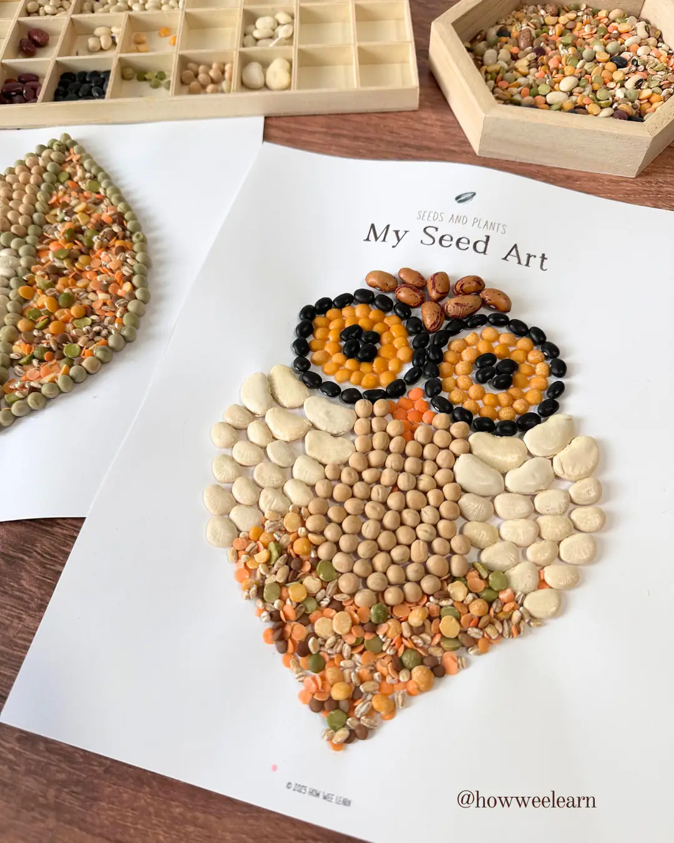
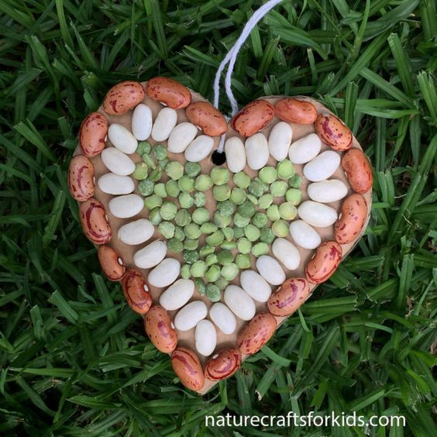

Slide 23
Lesson Plan 2: LITTLE HANDS GREENHOUSE
Implementation
Instructions step by step: 22 min
Students are shown the bean experiment video:
To do the experiment they watched in the video:
Give 2 cardboard cups, sufficient amount of cotton and bean seeds because they germinate easily
Each student moistens cotton in the cups and places the bean seed
Students place one of the prepared seeds inside the greenhouse and the other outside of the greenhouse.
They prepare observation journal to convey their observations of the bean seed sprouting process for both conditions. They can draw pictures, take notes in it day by day.
Students are asked to prepare a simple graph or table about the growth of the seed for future lessons.

Slide 24
Thank you for your attention!
Module 7
Game-based Needs Analysis for Ecological Problems
Osmangazi Municipality
Co-funded by the European Union. Views and opinions expressed are however those of the author(s) only and do not necessarily reflect those of the European Union or the European Education and Culture Executive Agency (EACEA). Neither the European Union nor EACEA can be held responsible for them.

