Slide 1
Module 8 STEAM Application Examples made on the Farm
Presented by
OMEM

Slide 2
Module 8 : STEAM Application Examples Made on the Farm
Students will learn about food science and technology and their application in agriculture.
Students will discover specific technology that makes job easier and faster in agriculture.
Students will investigate food preservation techniques used in agriculture.

Slide 3
Lesson Plan 1: Barnland
Teacher screens the cow photos, and asks questions about its needs? ( what do they eat? How do they feed themselves ? Who gives food them? Where they live? ) Students discuss the feeding methods with the teacher.

Slide 4
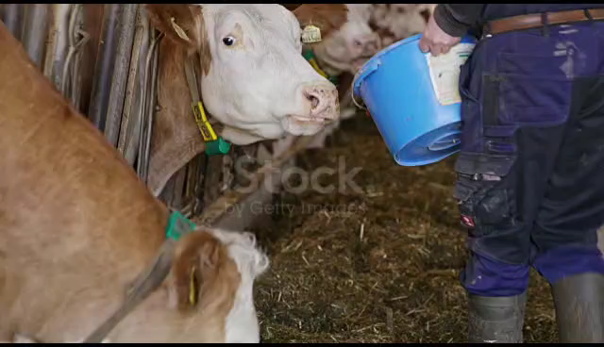
Lesson Plan 1: Barnland
Teacher shows the video to the students and asks them what they can do to make the job easier and how?
Student make a list on the white board.

Slide 5
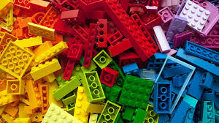
Lesson Plan 1: Barnland
The teacher gives the students the lego set and have them make a barn and a tool or a vehicle.

Slide 6
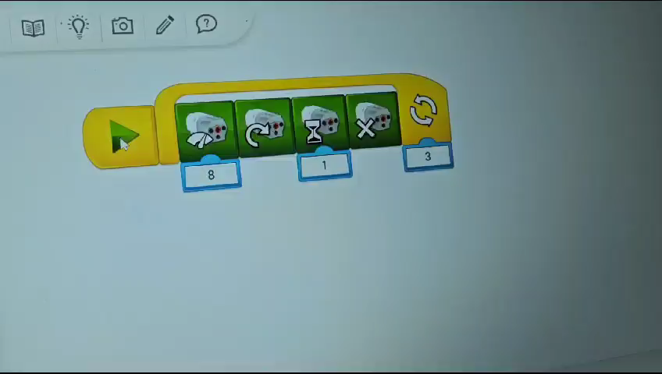
Lesson Plan 1: Barnland
At the end of the lesson students press the play button and discuss each of the steps, one by one!

Slide 7
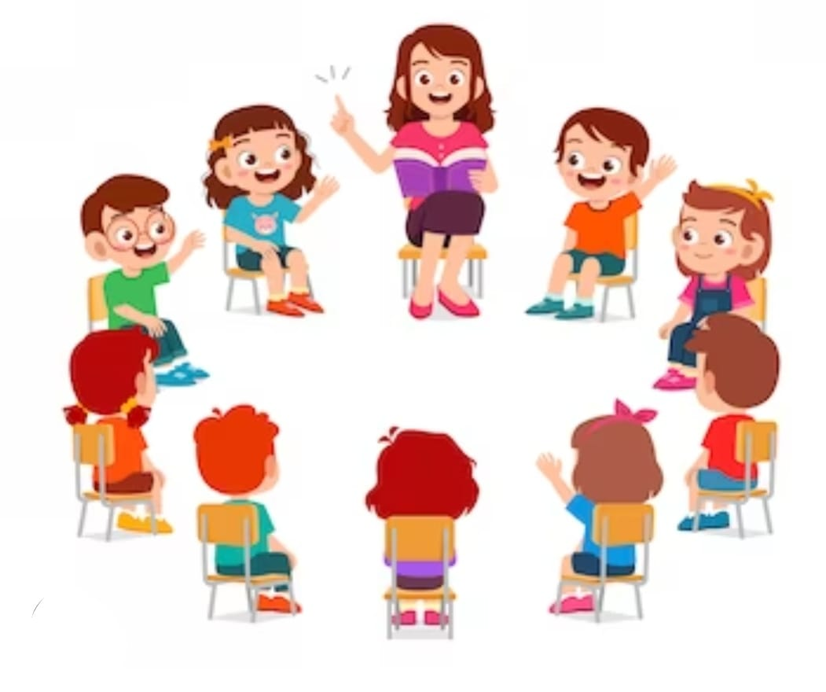
Lesson Plan 2: Fruitland
Teacher enters the classroom with a jar of jam and asks the students what it is, why do we need to make jam ? , what kind of preservation technique is it?...
Students discuss the techniques with the teacher.

Slide 8
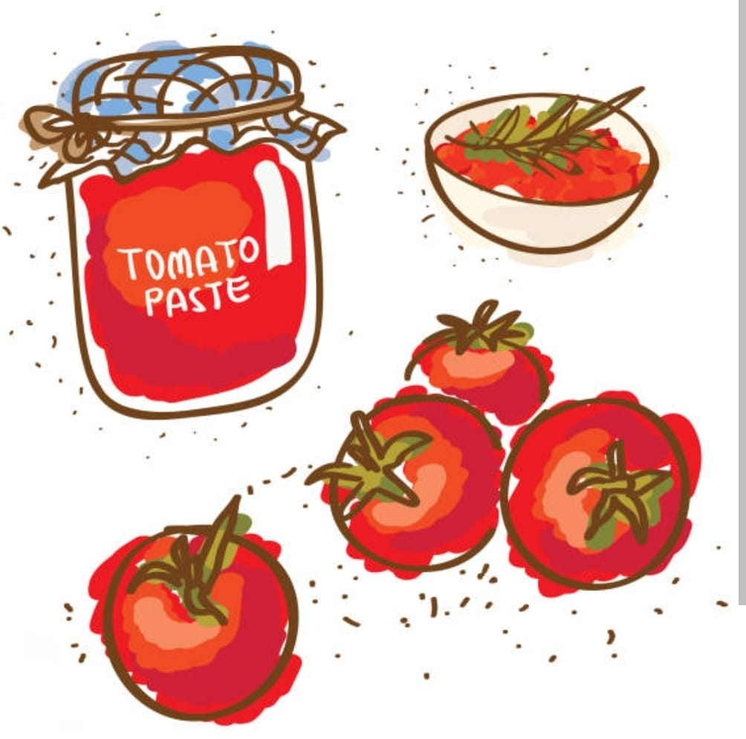
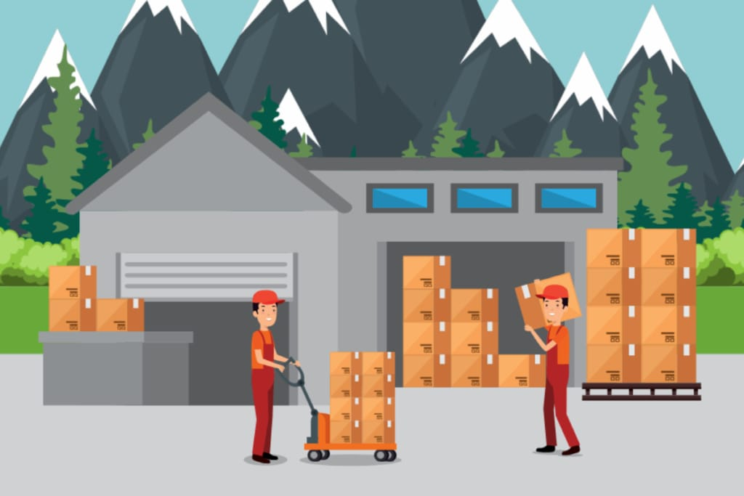
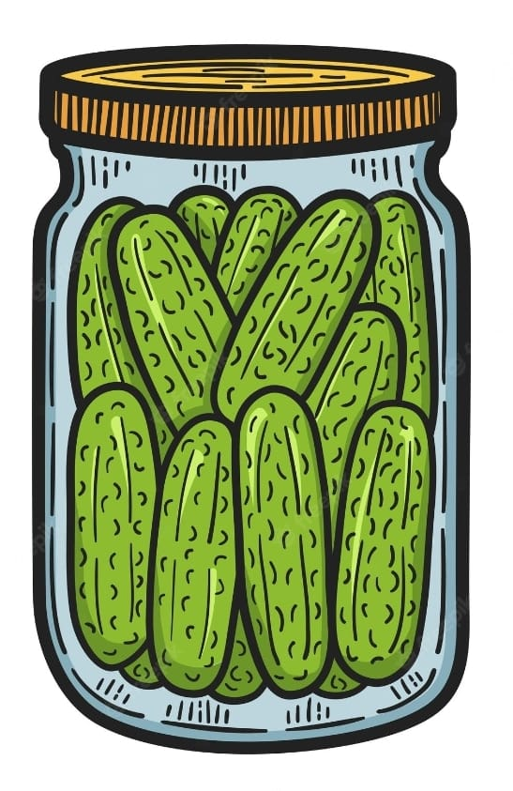
Lesson Plan 2: Fruitland
Students make a list of preservation techniques of food.
Tomato – paste –canning
Fruit –jam – cold storage
Cucumber,pepper, cabbage –pickle …

Slide 9
Lesson Plan 2: Fruitland
Teacher asks students the food preservation techniques.
(canning , freezing)
Students watch the video
https://www.youtube.com/watch?v=foT78hzZbXU
https://www.youtube.com/watch?v=-gRisxyou2Y
Students discuss how technology has changed over time.

Slide 10
Lesson Plan 2: Fruitland
Teacher gives the lego set to the students and have them make a farm and a cold storage.

Slide 11
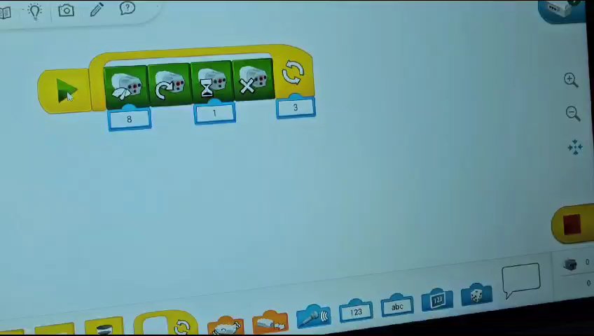
Lesson Plan 2: Fruitland
At the end of the lesson students press the play button and discuss each steps one by one.

Slide 12
Lesson Plan 2: Fruitland
Materials :a jar of jam
Videos on youtube
Lego WeDo 2.0
pc

Slide 13
Thank you for your attention!
Module 8
STEAM Application Examples made on the Farm
OMEM
Co-funded by the European Union. Views and opinions expressed are however those of the author(s) only and do not necessarily reflect those of the European Union or the European Education and Culture Executive Agency (EACEA). Neither the European Union nor EACEA can be held responsible for them.

